Slide 1
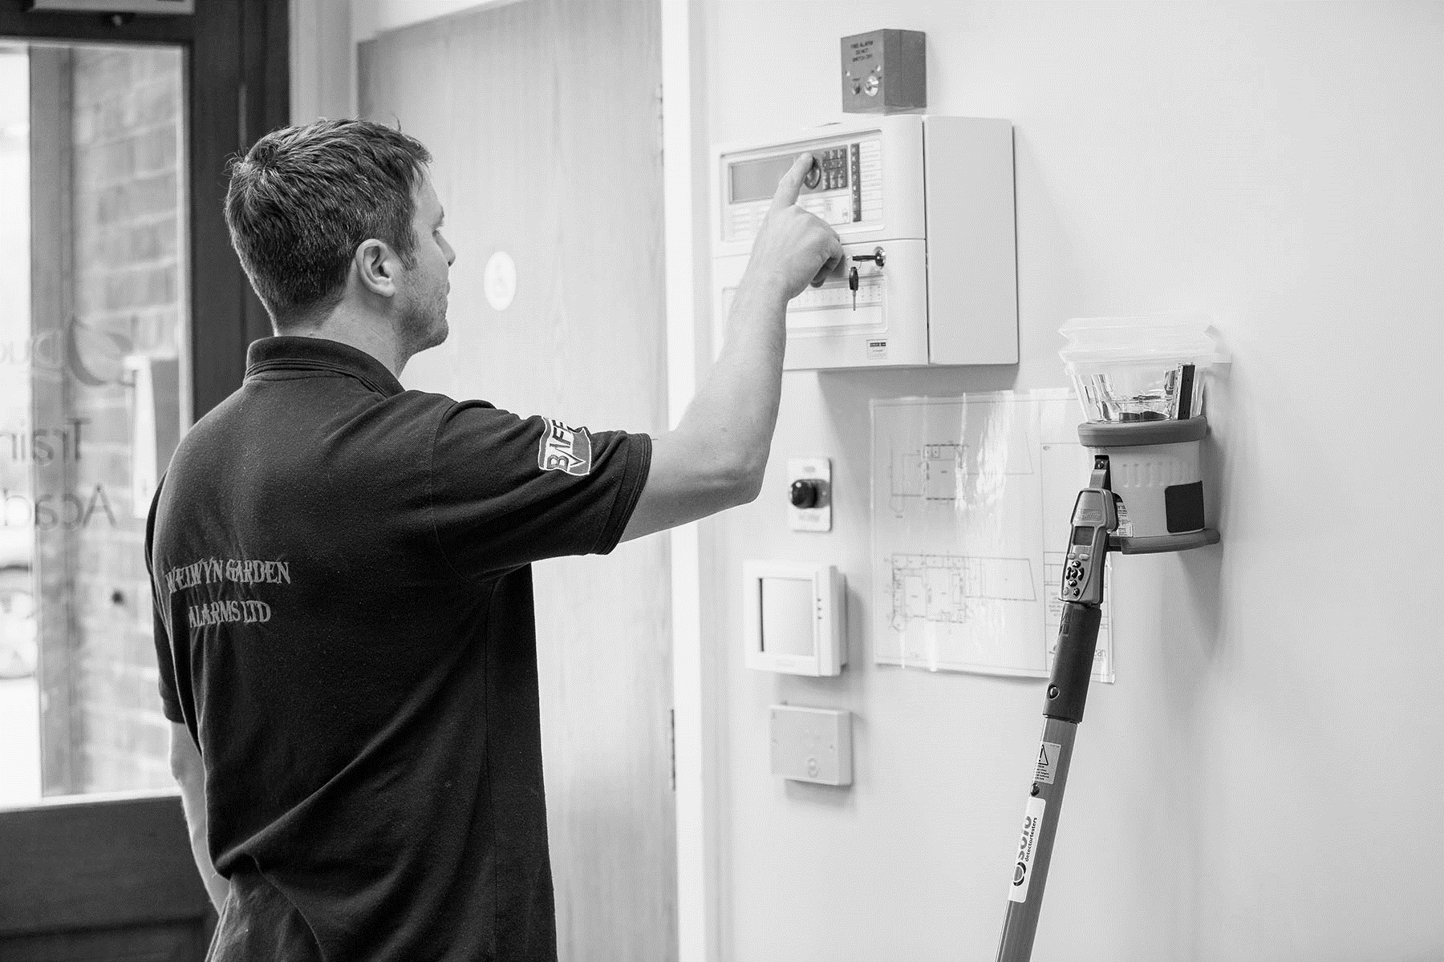


TESTING & MAINTENANCE OF FIRE DETECTION SYSTEMS
2020 CPD Revised Edition
Notes:
Revision Date: 16/03/2020 v2
This is a CPD Endorsed training course
Endorsed by the CPD Certification Service. The Coach House, Ealing Green, London W5 5ER
Certificate Number: A013855
Once you have attended this training course you are eligible to request a CPD certificate. Email: learn@detectortesters.com

Slide 2



PAUL GATENS
COURSE LEADER
Notes:
Your trainer: Paul Gatens
Employed at Detectortesters since 2007. Previously at Which? in Hertford and prior to that I was a Microsoft Certified Trainer. Served a 5 year electronics apprenticeship with Tektronix in Hoddesdon.
Currently, I look after training and social media support of our products. Working closely with detector manufacturer's and trade bodies.
Hobbies/Interest: walking the dog; motorcycling; cycling; running; climbing and kayaking
You can find out more information about Paul on the following social media links –
https://www.linkedin.com/in/pgatens/
https://www.facebook.com/PGatensDT
Detectortesters
Established 1965 and known as No Climb Products Ltd since 1995. Trading as detectortesters since 2008. Product ranges include Solo; Testifire ; Scorpion and Tio Fire.
Recognised global leader, distributing products to 150 countries from our base in Hertfordshire!

Slide 3
COURSE OVERVIEW
1
2
3
4
5
6
Competency & Responsibility
British Standards & Best Practice
Unwanted Fire Signals
Aerosol
Canisters
Solo 330, 460 & 423
Testifire
7
8
9
10
11
12
Solo 365
Solo Battery Batons, Chargers & Accessories
ASD System Testing
Removal & Cleaning
Working at Height
General Testing
Tips & Care of Products
Notes:
About this course.
This training course is designed to give an in-depth knowledge on the use of detectortesters functional test products and associated accessories in regards to use in testing fire detection systems in line with British standards.
It will cover British law (Regulatory reform Order 2005) and parts of BS5839:1 and BS5839:6 that relate to the use of the detector test products and also promote established best practice and detector manufacturer's recommendations.
This course is not a replacement for multi-day courses that cover test and maintenance of fire detection systems as available from the FIA; IFEDA; ECA/FSA etc.
Prerequisite
Although it is possible for someone with no previous experience to go through this course, ideally candidates should have some working knowledge within the fire maintenance industry.

Slide 4

The basic concepts of The Regulatory Reform (Fire Safety) Order 2005 (RRO)
The role and legal obligations of competent & responsible person
The role of the premises manager
How a competent person demonstrates competency
The importance to keep knowledge and skills, relevant and current
The basic duties of the competent person
The intent of the various BS 5839 clauses that relate to test and maintenance of fire detectors /alarms
The difference between commercial detectors and residential alarms
The importance of monitoring and reducing unwanted fire alarms
Understand what is meant by best practice
How to test detectors correctly using Solo; Testifire and Scorpion products
How to look after your test and maintenance kit
COURSE OBJECTIVES
By the end of the training course, you will have a full understanding and appreciation of the following subjects:
Notes:
Course objectives Notes:

Slide 5
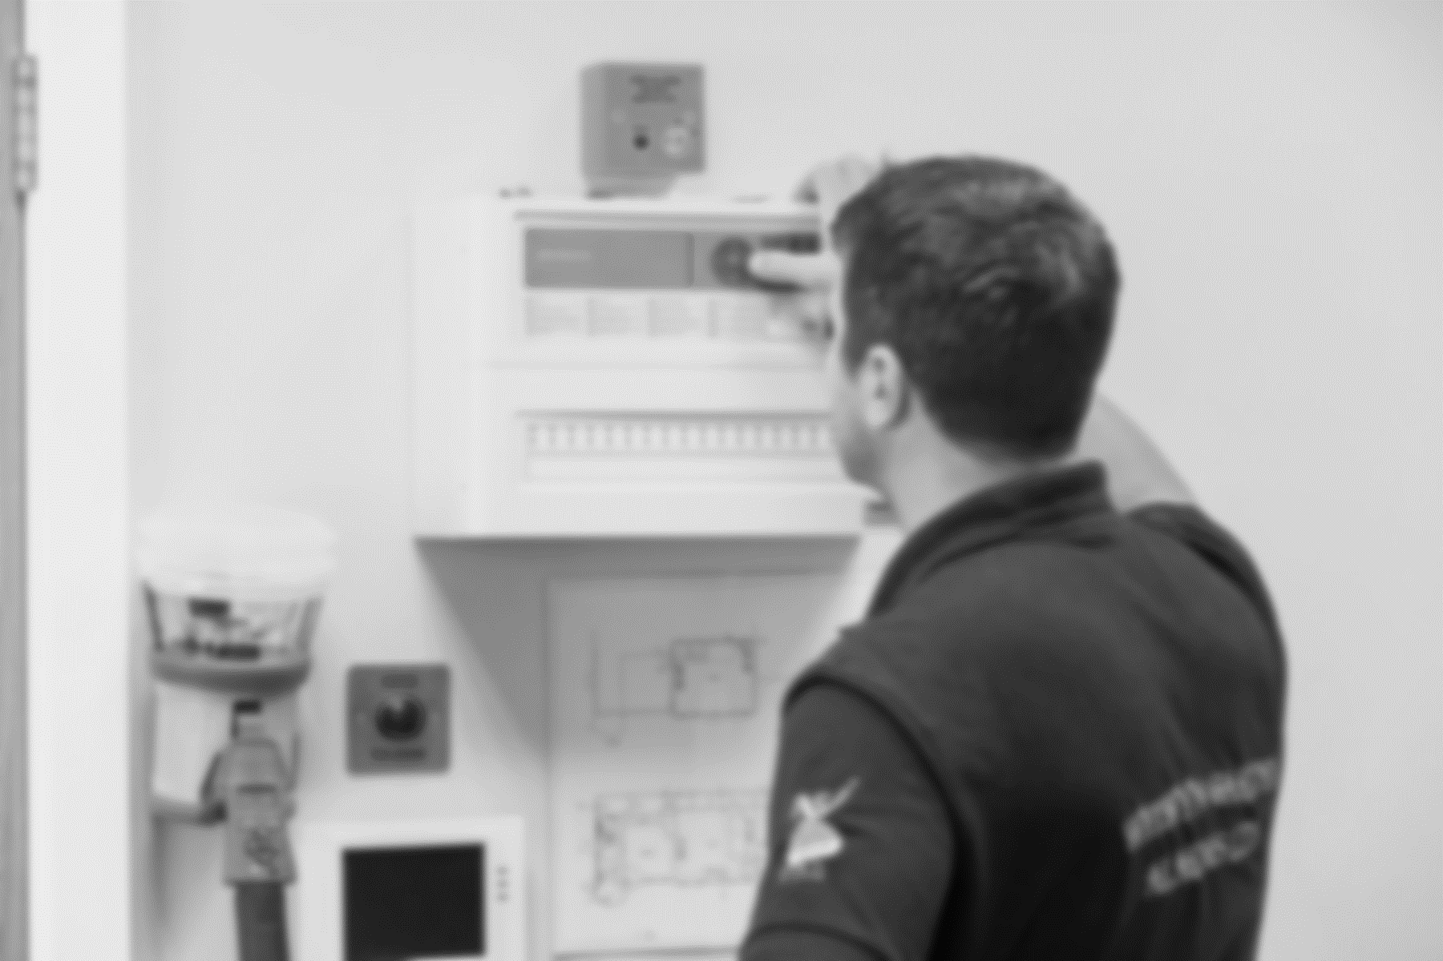

1
Competency & Responsibility
Notes:
Competency and Responsibility Notes:

Slide 6
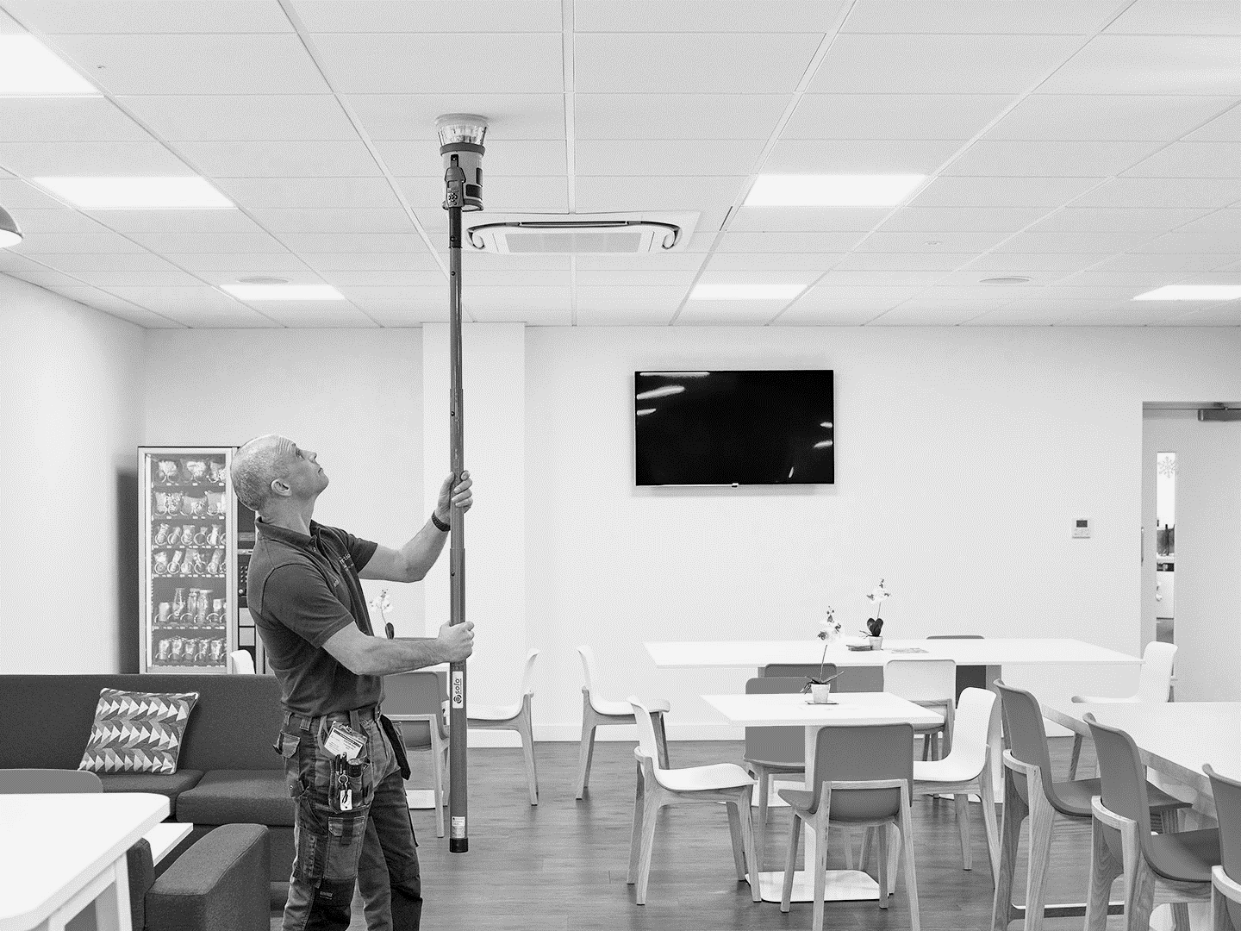
1. Competency & Responsibility
ENGLISH LAW AND THE BRITISH STANDARDS
British Standards is a code
of practice/recommendation,
it is not law
BS5839 Part 1 – 2017 = Commercial premises
BS5839 Part 6 – 2019 = Domestic premises
The Law = The Regulatory Reform (Fire Safety) Order 2005 (RRO)
Three basic concepts
Fire risk assessment (FRA)
Responsible Person (RP)
Competent Person (CP)
Compliance with British Standards cannot automatically confer legal immunity.
However, for a competent person and responsible person compliance with the latest code is obviously the best line of defence in any court case.
Notes:
The Law and British Standards
The Regulatory Reform (Fire Safety) Order 2005 (officially listed as The Regulatory Reform (Fire Safety) Order 2005 S.I. 2005 No. 1541) is a statutory instrument, applicable only in England and Wales. The Order places the responsibility on individuals within an organisation to carry out risk assessments to identify, manage and reduce the risk of fire. The Order was made into law on 7 June 2005 and came into force on 1 October 2006.
Guidance for Businesses and Organisation is available in the form of 16 Government Published documents, with general guidance, a 5-Step Checklist and 12 documents pertaining specifically to a particular type of business premises. It does not normally apply to domestic premises.
BS 5839-1:2017 Fire detection and fire alarm systems for buildings – Part 1: Code of practice for design, installation, commissioning and maintenance of systems in non-domestic premises
BS 5839-6:2019 gives recommendations for the planning, design, installation, commissioning and maintenance of fire detection and fire alarm systems in domestic premises that are:
Designed to accommodate a single family
Houses in multiple occupation that comprise a number of self-contained units, each designed to accommodate a single family
Sheltered housing, including both the dwelling units and the common areas.”
In the eyes of the law, the service and maintenance engineer needs to be able to prove that they are competent to perform the task of maintaining the fire detection system and to be able to prove they have followed the codes of practice (BS:5839:1 2017 & BS5839:6 2019). In the event it is not possible to follow the recommendations within the standard, it is important to have a good written explanation (known as a variation to standard).
Compliance with a British Standard cannot automatically confer legal immunity. However, for a CP and RP compliance with the latest Code is obviously the best line of defence in any court case.
You need to be familiar with relevant parts of the standard and the law, training is the best way to gain this knowledge
Recommended Code of Practice
Being ignorant; unaware; not having time or the right equipment is no excuse for not following the recommendations within the British standard!
It is in your interest to make sure that not only you have the right equipment; know how to use it, but you also know what is in the latest edition of BS5839:1 2017
Originally published in 1980, BS 5839-1 Fire detection and fire alarm systems for buildings. Code of practice for design, installation, commissioning and maintenance of systems in non-domestic premises, has become one of most important standards for fire detection in the United Kingdom.
BS 5839-1:2017 is a code of practice, and therefore, consists of guidance and recommendations. As the Foreword makes very clear, “[BS 5839-1:2017] should not be quoted as if it was a specification and care should be taken to ensure that any claims of compliance are not misleading. As a result, all users claiming compliance with this British Standard are expected to be able to justify any course of action that deviates from its recommendations.”

Slide 7

THREE BASIC CONCEPTS OF THE LAW
Responsible Person
The owner/occupier designated responsible person (under the RRO), must ensure that the regulations are complied with, and risk prosecution if they fail to do so
The responsible person must be able to provide evidence that their fire system is fit for purpose, being designed, installed, commissioned and maintained in accordance with BS5839 part 1
This is achieved by enlisting the help of a competent person, which is you!
Fire Risk Assessment
The Responsible person must be able to produce a current Fire risk assessment. – mandatory requirement
Competent Person
British Standards definition of a competent person (CP):
Person with the relevant current training and experience, and with access to the requisite tools, equipment and Information, and capable of carrying out a defined task
Notes:
Introduction to basic concepts of the Regulatory Reform (Fire) Safety Order 2005
There are 3 concepts that are fundamental to the success of the RRO, firstly the “Responsible Person” concept, secondly the “Risk Assessment” concept (the idea being that the ‘responsible person’ will conduct a fire risk assessment and ensure that the premise that he or she is responsible for is safe from fire for all person’s that resort there) and Thirdly the concept that a fire should not start in the first place as opposed to previous legislation that focussed on the measures required to reduce the effects of a fire that had already broken out.
The ‘responsible person’ will need to enlist the help of a ‘competent person’. ‘Competent Person’ is anyone appointed by the ‘Responsible Person’ and could be anyone from a company fire warden to a fire alarm service engineer, they may be directly employed or a subcontractor but the important word is competent
All fire alarm engineers must be Competent in the field of work they carry out, the British Standards states:
Competent person
Person with the relevant current training and experience, and with access to the requisite tools, equipment and Information, and capable of carrying out a defined task.
Note on Responsible person. RRO continues to use the term Responsible person although the updated version of BS 5839: 2013 has replaced references to Responsible person with ‘Premises Manager’.
BS5839:2013 also made a small change to the definition of the competent person. Changing to ‘necessary training’ to ‘relevant current training’ which serves to underlines the need for update and refresh training.
Fire Risk Assessment
The Regulatory Reform (Fire Safety) Order 2005 requires that a Fire Risk Assessment is carried out on all commercial premises, and also on the communal areas of residential premises. Who can carry out a Fire Risk Assessment? The Order further requires that this assessment is undertaken by a 'competent person'.
It's mandatory to carry out a detailed assessment identifying the risks and hazards in the premises. It must be recorded if you have a total of five or more employees.
The responsible person for the premises is also required to:
Consider who may be especially at risk.
Eliminate or reduce the risk of fire as far as is reasonably practical.
Provide general fire precautions to deal with any risk.
Take additional measures to ensure fire safety where flammable or explosive materials are used or stored.
Create a plan to deal with any emergency and where necessary record any findings.
Maintain general fire precautions, and facilities provided for use by firefighters.
Keep any findings of the risk assessment under review.

Slide 8

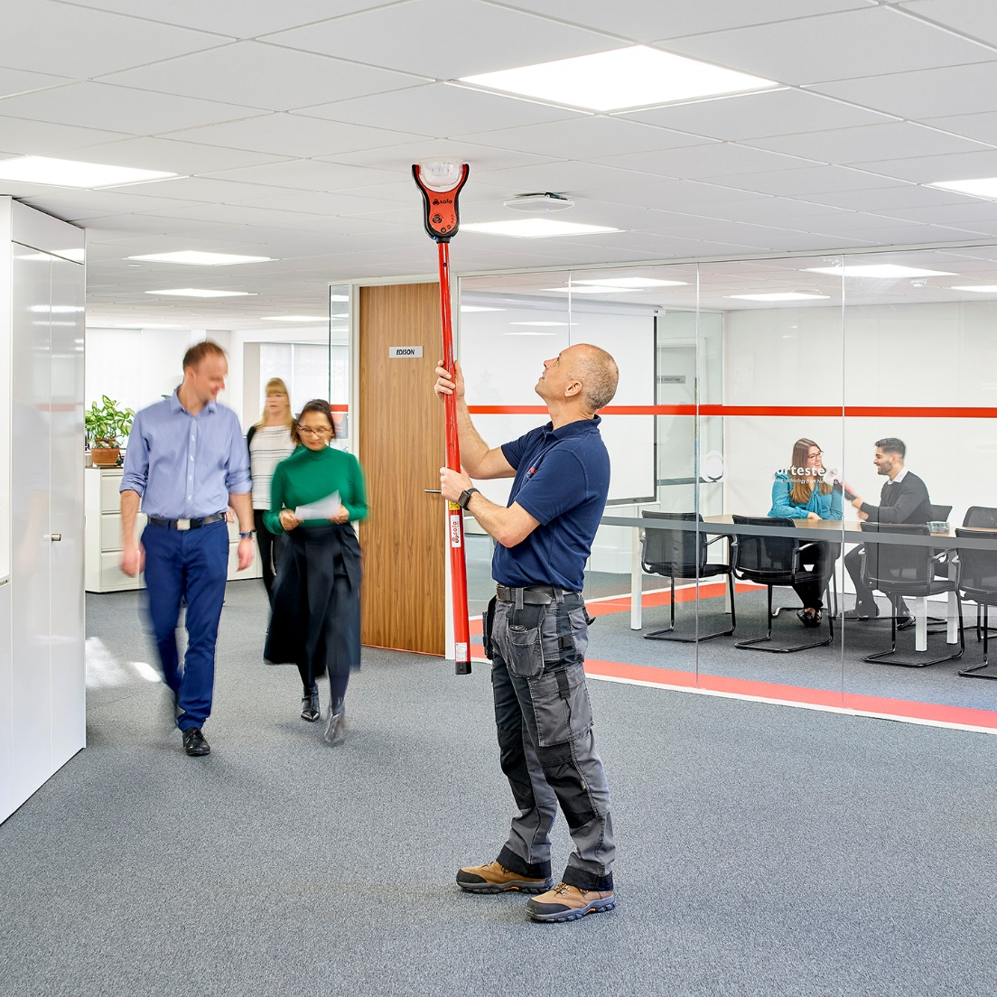

1. Competency & Responsibility
HOW TO DEMONSTRATE COMPETANCY?
For the Competent Person (Engineer)
Through training and accreditation
Good knowledge of standards & Industry/manufacturers ‘best practice’
Document all recommendations to the client
Keep Training current in the following three areas:
Standards
Manufacturers product training
Health & Safety training
Continuous Professional Development (CPD)
Certificated CPD training helps prove competency
How does a company demonstrate competency?
Third party certification, as awarded by a UKAS accredited body such as BAFE and LPS 1014
Notes:
How do you demonstrate competency
Demonstrating the competency of Fire Alarm Company and employees is very important.
For those that carry out the design, installation, commissioning and/or maintenance of fire alarm systems they need to demonstrate that they are qualified to carry out such work. This is achieved through accredited competency training.
Standards training
Accredited competency training as offered by FIA/FPA/IFEDA/FSA etc. covers the standards and concepts of fire alarm systems in regards to relevant tasks. eg. Design; Install; Commission and Maintenance
Manufacturer's training
manufacturer's product training covers the relevant product knowledge on the fire systems and equipment that you plan to work on or with. Often manufacturer's training is free!
What is CPD?
Continuing professional development (CPD) is the intentional maintenance and development of the knowledge and skills needed to perform in a professional context. This could mean honing current skills, it could mean developing them to a new level, or it could mean learning new ones that will allow an employee’s job role to expand or prepare them for potential promotion. It is recognised that CPD is a good method to document and prove competency.
Third party certification
Obtaining third party certification (Usually BAFE or LPS 1014) for your company will demonstrate that the company has competencies and quality management systems in place to meet the requirements of the British Standard. This case highlights that whatever the background of the individual providing the service, there is no substitute for proper assessment by a competent body, to a scheme that clearly sets out the requirements for correctly designing, installing, commissioning and maintaining the system.

Slide 9
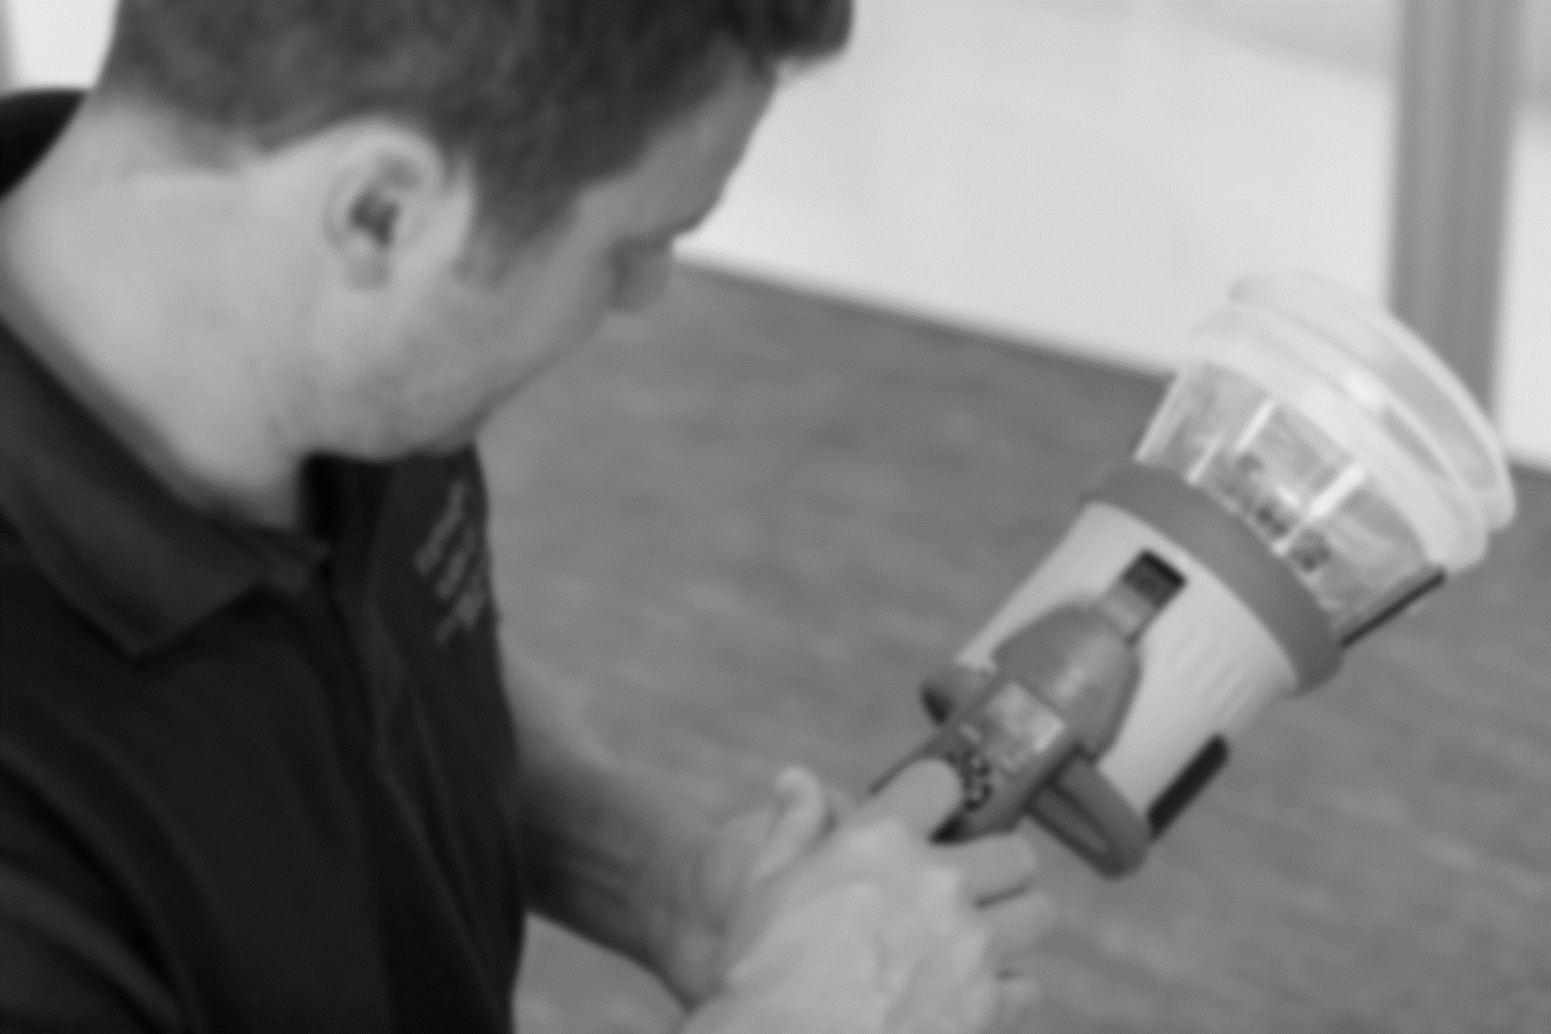
1. Competency & Responsibility
ARE YOU COMPETENT
OR JUST CAPABLE?
Hackitt
Report:
Mentions the word ‘competency’ 152 times in her report!
Capable = Perceived and assumed ability
Competent = Proven and demonstrated ability
  Regulatory Reform Order & BS5839 calls for a Competent person, not a Capable person
Notes:
Hackitt Report: mentions the word ‘competency’ 152 times in her report!
Are you competent or just capable?
Proving your competency is very important as it enables you to cover your back! The Fire industry generally accepts that the most cost effective way to achieve this is via third party approved training. CPD (Continuing professional development) should also be considered as way for fire engineers (and fire alarm company) to demonstrate competency, with documented proof that each engineer has kept up with legislation; product development; new technology in regards to the skill set they offer (Design; Install; Commission and Maintenance)
Can you prove that you are competent to install, commission or maintain a fire detection system?
You might be asked to proof competency in the event of a fire on a site that you are maintaining

Slide 10


1. Competency & Responsibility
WHO IS RESPONSIBLE FOR FIRE SAFETY?
Responsible Person
Normally the employer, manager or owner is responsible
(Responsible Person (RP) under the Regulatory Reform Order)
In The Law Courts
Both RP and PM (employee) can both be implicated
Unlimited fines and up to 20 months imprisonment
‘Matrix of responsibility’ is widening
Engineers and Risk assessors have been prosecuted. Who next? Service managers or owners of service companies?
Regulatory Reform (Fire) Safety Order 2005 is under review. Better definition of responsibilities?
Hackitt
Report:
“Don’t wait for regulations to raise the bar”
  Premises Manager
  Changes to BS5839-1 in 2013, Section 7, Clause 47
  Responsible Person was replaced by Premises Manager (PM)
  Has the budget, authority and the knowledge to look after the system. Can be the same person as the Responsible Person in a smaller company
Notes:
Hackitt Report: “Don’t wait for regulations to raise the bar”
Responsible person
The term ‘Responsible Person’ is unfortunately used in two ways in the fire industry. The law uses the term to describe the person who is in control of the building – he/she is the legally responsible person. BS5839-1 2002 used the same term for the person who is responsible for the fire system. 2013 release has changed the term to Premises Manager. Both references could be to the same person, but in most cases the legally responsible person will appoint someone to be responsible for the fire alarm system – so they are not the same.
The Premises Manager/Responsible person should have adequate authority, so that he/she is able to get things done if repairs are needed and he must be adequately trained so that he can ensure that the system is working correctly for 365 days of the year. The fire CP may only be on site for two days in the year, so the RP is critical for fire safety in buildings.
Competent Person
For further reading on Enforcement and the Fire Alarm Engineer - http://www.firesafetylaw.co.uk/enforcement-and-the-fire-alarm-engineer/
Also worth following Warren Spencer from the above website. You can subscribe to his newsletter. Highly recommended!
Matrix of responsibility
Following on from Grenfell Fire and the Hackitt report courts and the law are looking at who else could be held responsible. If the fire alarm engineer does not have the correct or serviceable test and maintenance equipment could the service manager or owner of the service company be held accountable?
As of 2019, the RRO is under review and it is looking bring it up to date. It is suspected that it will make it possible for others who are involved could be held responsible.
In the Law courts changes have already been made and unlimited fines and up to 20 months imprisonment can be awarded.

Slide 11
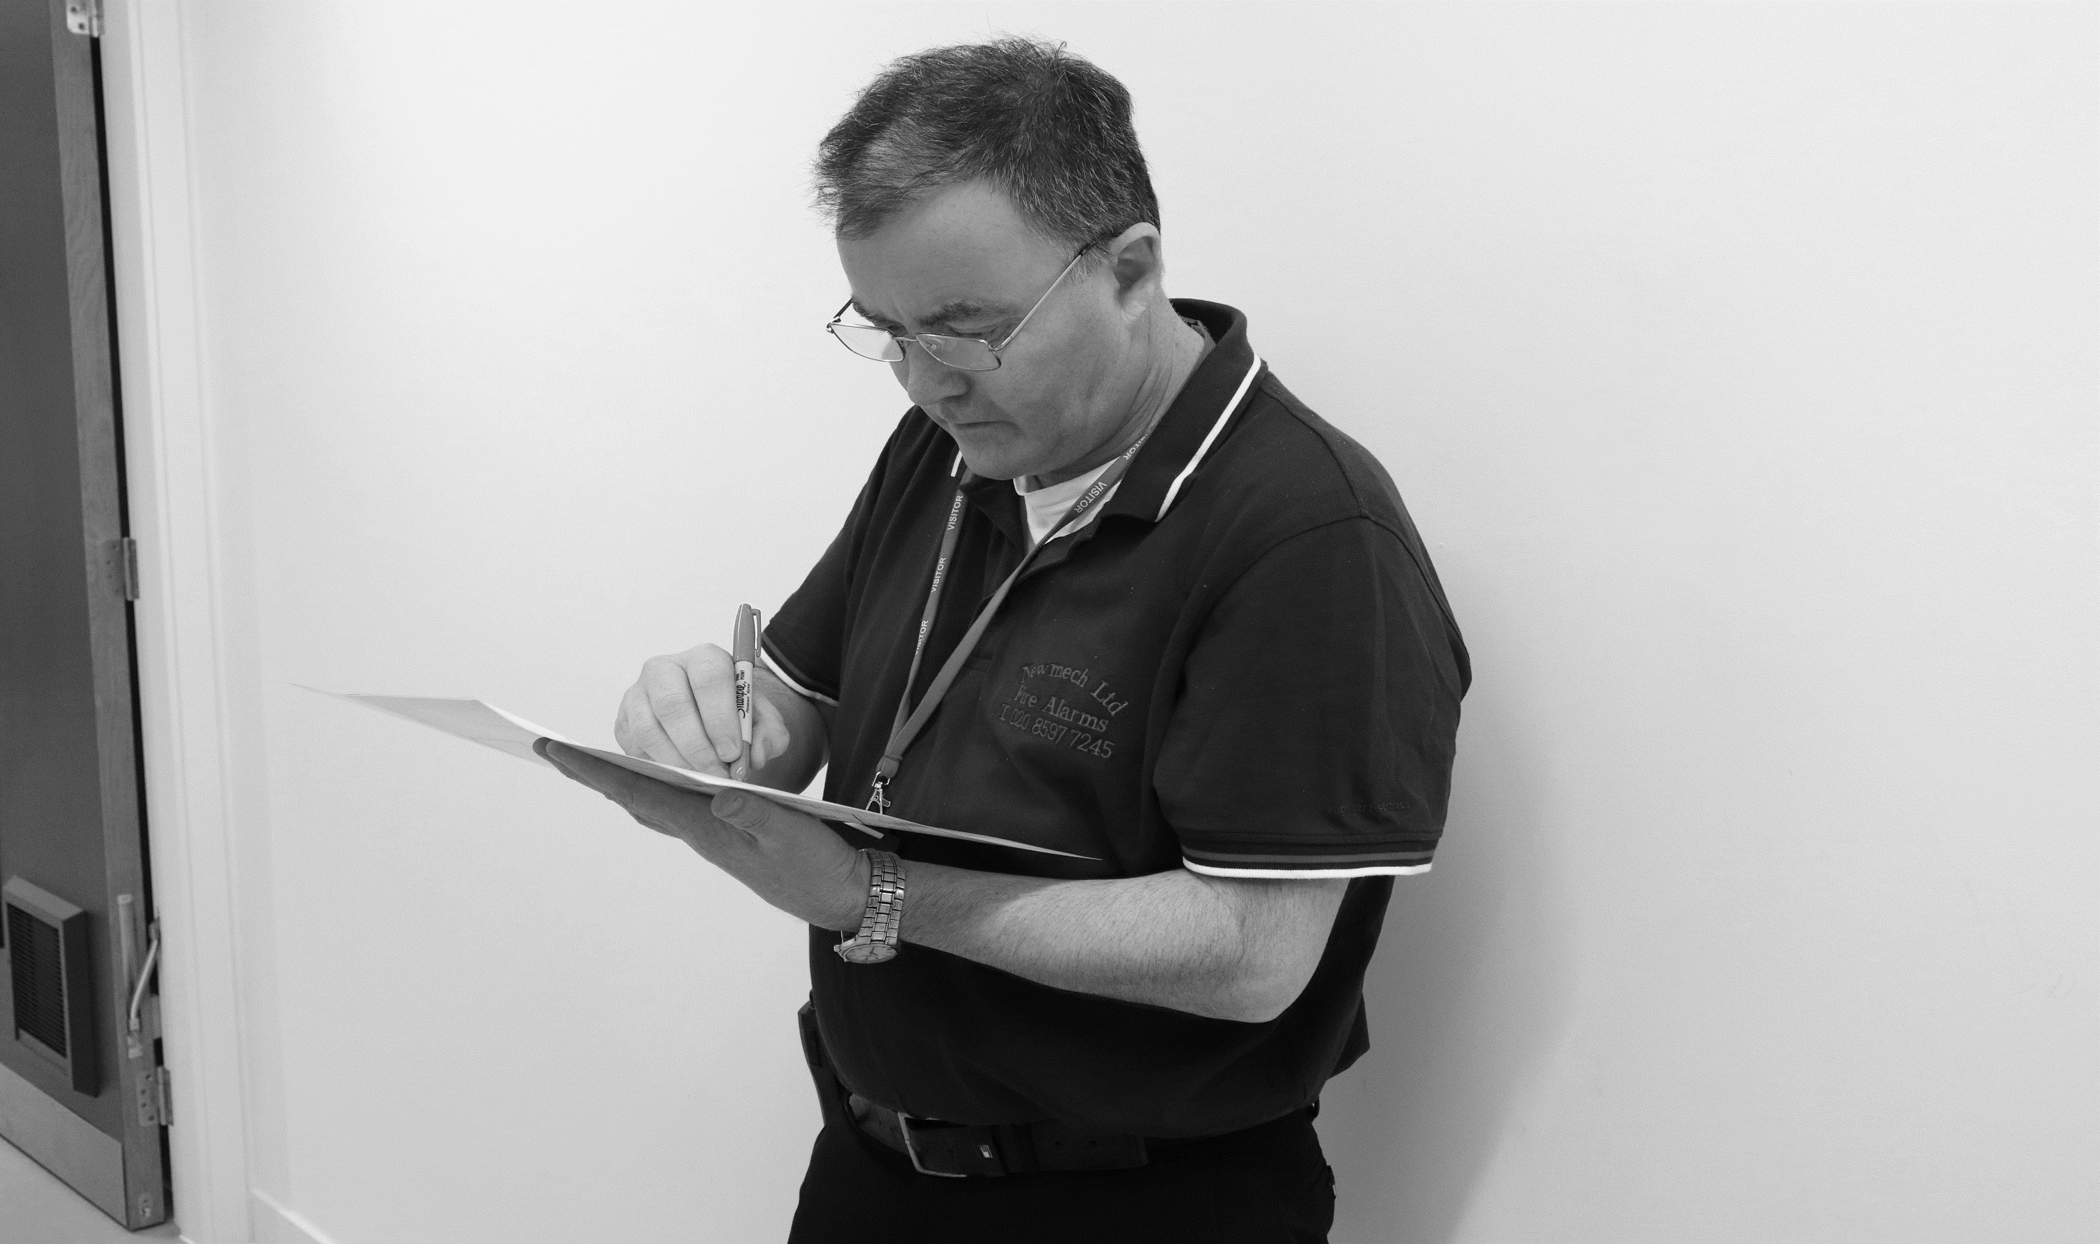
1. Competency & Responsibility
THE FIRE SAFETY LOG BOOK
Hackitt
Report:
“Golden thread of information”
  Must be kept up to date and readily available for inspection/audit by the Fire and Rescue Service as and when required
  The Engineer (Competent Person)
  Needs to be familiar with the Fire Safety Log book for any site they maintain
  It should contain important information to assist with on going maintenance
  Make sure it is kept up to date
  It can be used in a court of law to defend the RP/PM and CP
Notes:
The Importance of Fire Safety Log book
Must to be kept up to date and readily available for inspection/audit by the Fire and Rescue Service as and when required.
The engineer (CP) should check this is being done.
Hackitt report “Golden Thread of Information”
The Hackitt report talks about a digital record for every building: a “golden thread of information” about each high rise residential building. But why not for all buildings? A single repository of information, from initial design through construction and to all subsequent changes throughout occupation, would benefit all end users of buildings. Software developers maintain detailed design and change logs, detailing what changes have been made and why: why shouldn’t we have the equivalent for the buildings we live, shop, relax and work in, to ensure that they are and continue to be safe and fit for purpose? Such a record would help ensure accountability for decisions and dis-incentivise corner-cutting for the sake of cost.
Poor on site documentation is an all too frequent occurrence. Fire log book not kept up to date by either the RP or in some case CP. No record or details on UFS.
TIO Fire
Log Book
Tio centres around an online interactive fire safety log book – accessed whenever and wherever needed.
False Alarm Manager
Tio makes it quick and easy. Details are shared, equipment checked, systems reviewed, false and unwanted alarms prevented and remedies provided. You and the fire brigade save valuable resources.
Compliance Assistant
Compliance reminders guide you on what to do, when and how; and its simple, intuitive design makes record-keeping easy.
Fire Document store
There’s a place for all your fire safety documentation too: vital documents such as risk assessments, certificates, site drawings, evacuation plans, recommendations and quotations.
Key / Emergency Contacts
Tio keeps all your emergency contacts in the loop, not only does it keep them neatly stored within the app; it also notifies them of any activations or reports.

Slide 12
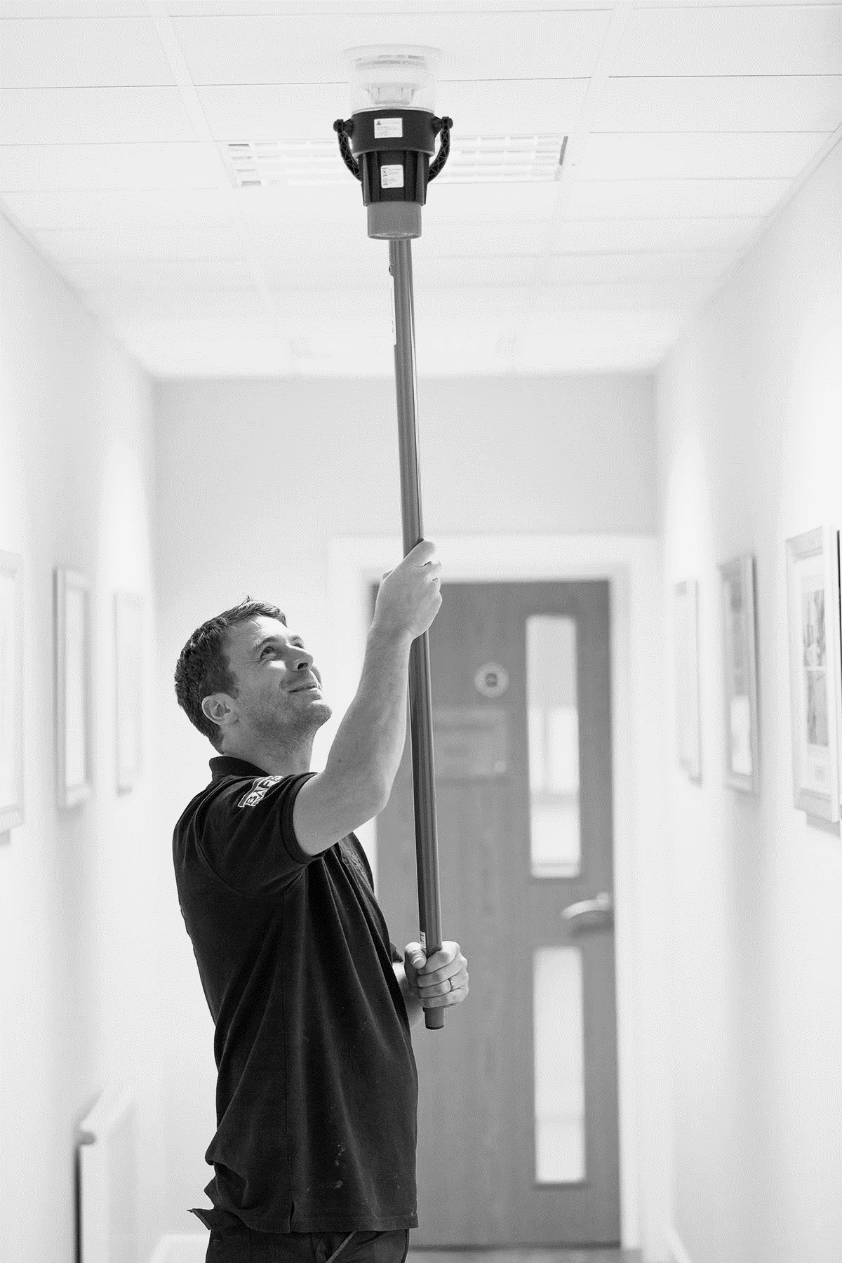
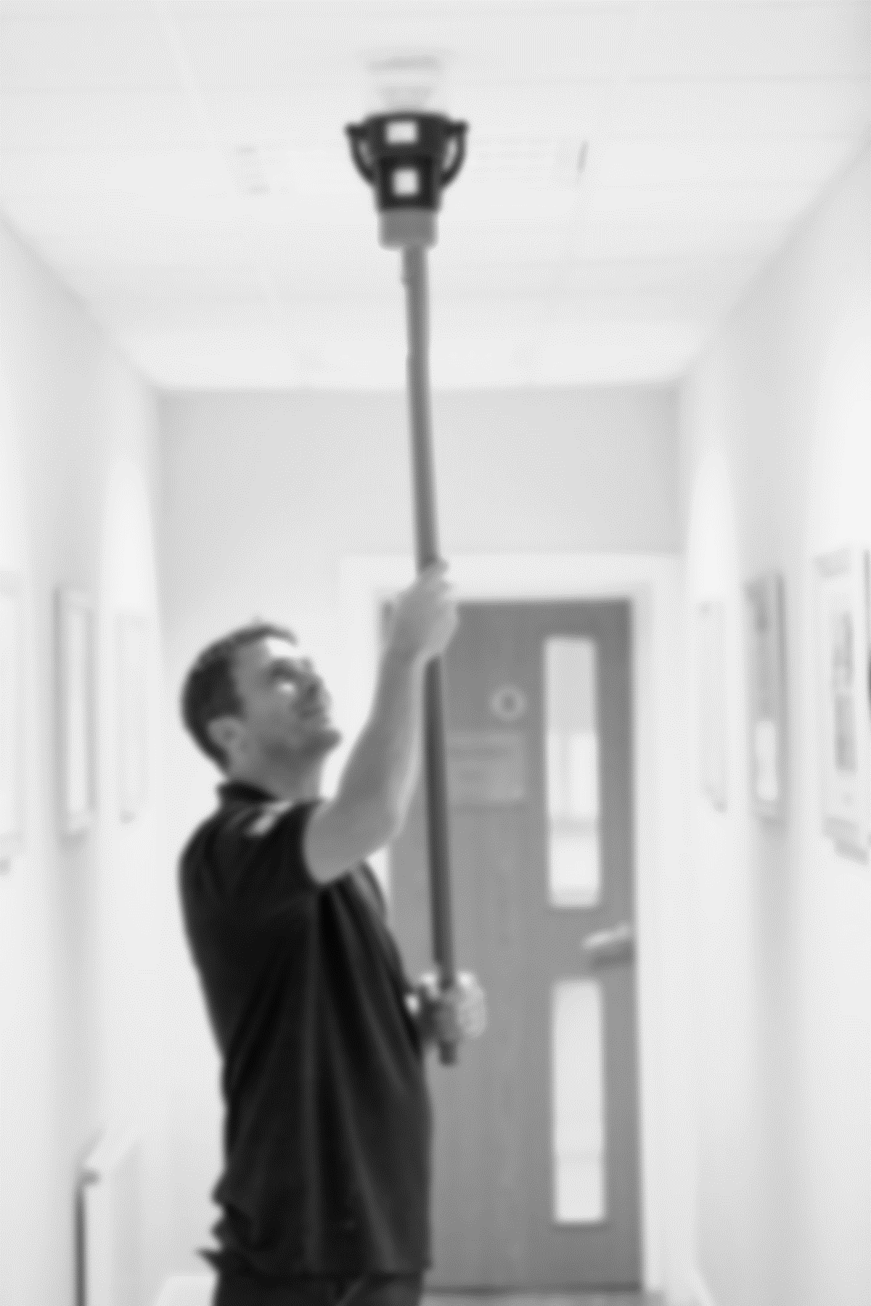
1. Competency & Responsibility
OVERVIEW OF THE COMPETENT PERSON ROLE
  Help, advise and train the RP/PM
  Provide technical know how
  Give all relevant recommendations/best practice in writing
  Independent review / inspection
  Carry out detailed tests, repairs, modifications
  Work with RP/PM to identify causes of unwanted fire signals (UFS)
  Keep up with changes in standards and best practice
  Record and make sure the log book is being kept up to date
Notes:
Competent Person (CP) role
Traditionally fire alarm CP will view their job as doing a series of technical tasks to keep the equipment, in this case the fire alarm system, in good working order.
However BS5839-1 looks at the role of the CP from a very much more holistic point of view.
It is an unfortunate fact that many building owners (RP) are only concerned about the fire system when it false alarms and are only concerned with fire safety when they have to do something to comply with the law or when they have just suffered the consequences of a fire. This is where the CP comes in. His role is both to look after the system technically and act as a teacher and to some extents a policeman to ensure everything is being done correctly.
The RP should be trained on the fire system when the system is installed. However many RP’s roles are much shorter than the life of the fire system. Therefore the CP has to train the RP in what his role is with respect to the fire system. He will also have to provide training with respect to what things will cause false alarms and how the system needs to be tested and looked after to make sure it does what it is meant to. This is the role of training and visual inspection of the site.
The tests also have to be done to confirm that all is well with the system and a check on false alarms is needed to make sure that nothing is drifting.
Often a reminder of the need to keep the log book up to date is also necessary.

Slide 13
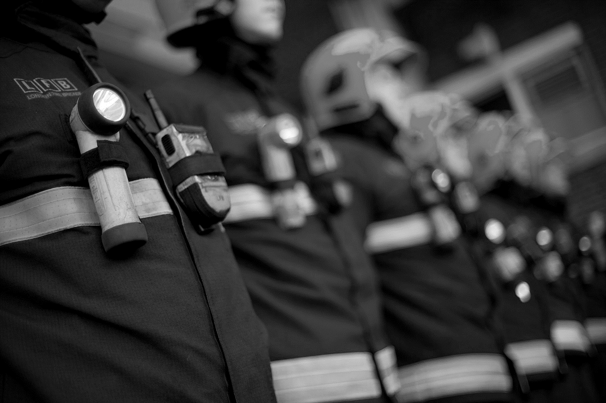
1. Competency & Responsibility
ROLE OF THE FIRE BRIGADE
  No longer issuing fire safety certificates (since RRO)
  Focus on reducing cost relating to Unwanted Fire Signals (UFS)
  Potential fines for RP’s in the event of repeat UFS (Localism Act 2011)
  In England, every FRS has its own attendance policy
  Now being targeted to increase inspections and prosecutions
  Drive to offer a more cost effective fire service
Notes:
Role of the fire brigade since 2006
The RRO was introduced in 2006 and the requirement for the FRS to issue fire safety certificates was removed.
The role of the FRS changed and many brigades found themselves falling into a Policing role and collecting information to carry out prosecutions of non-compliance and blatant offenders. A number of RP’s were prosecuted and 1 CP was prosecuted in the early days.
The time and cost associated with collecting information for a prosecution is high and continued government cutbacks has result in a reduction of cases brought to the courts.
The FRS have more recently changed their approach and are now focussing on the number of unwanted fire signals (UFS).
In England, a lot of confusion exists around the different regional brigades and the different responses to automatic fire signals. Some will respond to automatic signals others will call challenge (seek confirmation of smoke and flames).
Localism Act 2011
The laws outlined in the Localism Bill mean that individual fire services throughout the UK can charge per false fire alarm. Fire and rescue authorities in England or Wales will be able to charge for the time they spend responding to false alarms from commercial buildings. Plenty of countries in Europe have already enforced a similar strategy, with England and Wales relatively late in bringing in this new legislation.
A false report can be made by an employee, or from malfunctioning or incorrectly installed fire detection equipment. If a fire and rescue authority decides to charge for taking action as a result of a false alarm, the amount charged is set by the local authority and can vary depending on circumstances. All local authorities within England and Wales will have the authority to enforce a charging system or unnecessary call-outs.
The fire and rescue authority can only charge up to the costs incurred – they cannot make profit through charges. However, taking into account the costs associated with sending out two fire engines and two teams of fire fighters (reputed to be £5,000 per tender), plus their specialist equipment, this could be a considerable amount. Some brigades are against charging, as this could result in companies becoming reluctant to call the fire service. Therefore, although the general consensus is that authorities should enforce charges, some may decide not to.
The amount charged is set by each local authority, not nationally, and will be different depending on circumstances.
Several FRS have introduced fines for repeat UFS and others are considering doing so
Devon and Somerset Fire and Rescue service was one of the first to implement fines.
http://www.thisissomerset.co.uk/false-alarm-regulars-face-300-fine/story-15533947-detail/story.html
Other FRS have since followed.
West Yorkshire
http://www.wakefieldexpress.co.uk/news/wakefield-district/false-fire-alarm-bill-to-hit-businesses-1-6232273
London Fire Brigade are now charging
http://www.bbc.co.uk/news/uk-england-london-25546816

Slide 14
1. Competency & Responsibility
  RP/PM/CP unaware of legal responsibility and implication of cutting corners
    No record of details on UFS
    Fire log book not kept up to date or missing
    What it is to be responsible or competent
  RP/PM has no way of checking/proving what work carried out. Is the CP cutting corners?
    Detectors in hard-to-access locations - many are not tested
    Optical smoke detectors that are not regularly cleaned can cause UFS
    What has been tested and what needs to be tested = where is the asset register?
WHAT ARE THE COMMON ISSUES?
    Checking the competency of the competent person (are they current and relevant?)
    Is the service company third party accredited? (BAFE etc)
  Competent Person not always documenting all recommendations; best practices and issues
Notes:
What are the common issues?
Some detectors are in hard to reach locations and many go un-tested. Variations to the standard are often incorrectly written. 2017 edition of BS5839:1 – clause 22 has a new paragraph to prescribe testing
No asset register of devices attached to system, means there is no way of keeping a record of what has been tested against what should be tested. This can mean that many detectors that are reachable go untested and some detectors are over tested.
There is a need for the RP to have more vision and control over what fire detection devices are attached to the system and what the state of test is. Also what age are the devices and when will they need to be replaced. In many cases the RP has no way of checking or keeping tabs on the system. This is not a good state of affairs as he/she is responsible.
Tenders and economics can mean the cheapest contract is signed. This can lead to corners being cut and testing of detectors not being carried out.
Poor on site documentation is an all too frequent occurrence. Fire log book not kept up to date by either the RP or in some case CP. No record or details on UFS
From 2017 edition of BS5839:1, there is a prescribe recommendation to test all enable sensors in multisensors. This may well be overlooked by engineers that have not kept up with their training.
After Grenfell, Insurance companies are taking more interest and encourage RP/PM’s to seek proof of what is being tested.
One simple step is to encourage the use of online Fire Log book services that simplifies the task of proving compliance for the RP/PM. – See - http://www.tiofiresafety.com
The above are a list of common issues that you need to be aware of and to do what you can to make sure that they do not occur on the sites that you maintain.
O

Slide 15
TESTING & MAINTENANCE OF FIRE DETECTION SYSTEMS
COURSE OVERVIEW
2020 CPD Revised Edition
1
2
3
4
5
6
Competency & Responsibility
British Standards & Best Practice
Unwanted Fire Signals
Aerosol
Canisters
Solo 330, 460 & 423
Testifire
7
8
9
10
11
12
Solo 365
Solo Battery Batons, Chargers & Accessories
ASD System Testing
Removal & Cleaning
Working at Height
General Testing
Tips & Care of Products
Notes:
Up Next –

Slide 16

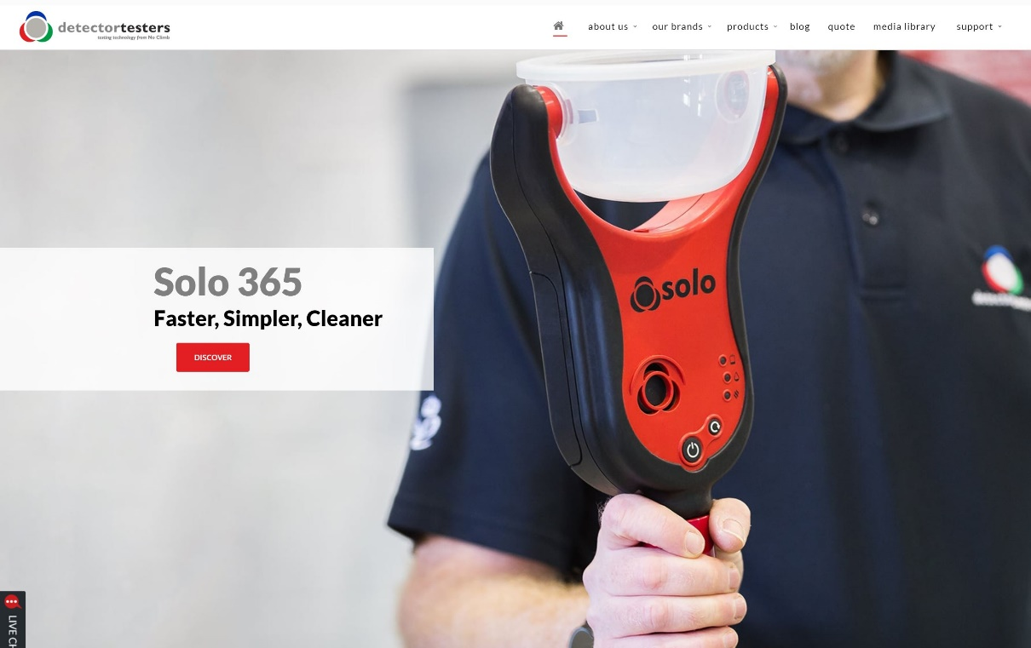
KEEP IN TOUCH
Detectortesters1
@NoClimbProducts
Detectortesters (No Climb Products Ltd)
Detectortesters1
Notes:
That concludes this section…
If you want to know more about our products, please see the detectortesters website or alternatively check out some of our product videos on YouTube.
We also have other training courses available on our website.
Look forward to you joining me on the next section

