Slide 1
TESTING & MAINTENANCE OF FIRE DETECTION SYSTEMS
COURSE OVERVIEW
2020 CPD Revised Edition
1
2
3
4
5
6
Competency & Responsibility
British Standards & Best Practice
False Alarms
Aerosol
Canisters
Solo 330, 460 & 423
Testifire
7
8
9
10
11
12
Solo 365
Solo Battery Batons, Chargers & Accessories
ASD System Testing
Removal & Cleaning
Working at Height
General Testing
Tips & Care of Products
Notes:
Up Next –

Slide 2
8
Solo Battery Batons, Chargers & Accessories

Slide 3
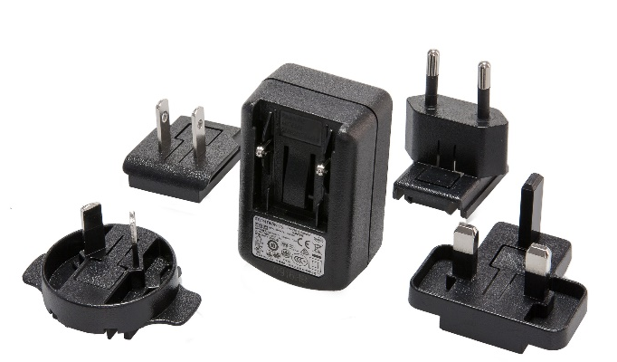
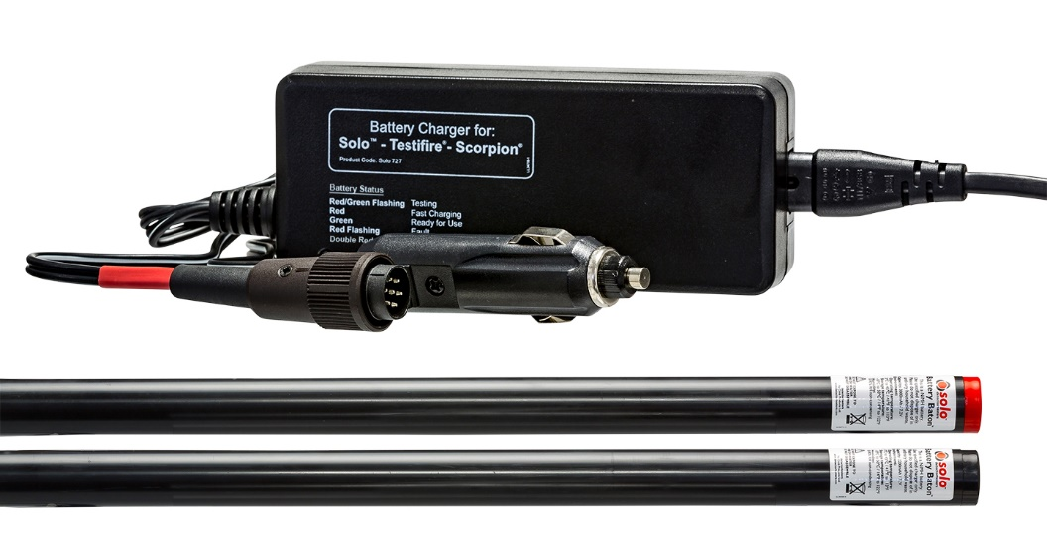
8. Solo Battery Batons, Chargers & Accessories
SOLO BATTERY & CHARGER COMPATIBILITY
New Solo 727 Mk2 Charger
Compatible with:
Solo 760 Battery Baton
Solo 770 Battery Baton
Solo 365 Universal Charger
Compatible with:
Solo 370 Battery Pack
Notes:
Solo battery baton and chargers
As with lots portable tools and gadgets these days most are powered by NiMH or Lithium battery packs. (NiCad's on the whole have been replaced long ago). Many of us do not appreciate that rechargeable batteries have a serviceable life and will at some time need to be replaced.
Typical life expectancy for lithium or NiMH battery packs is around 500 recharges or 2-3 years, after such time the period between charging starts to decrease as the cells start to deteriorate. Once the battery usage time is less than the charge time, it is recommended to replace the battery. (charge times: Up to 90 mins for Solo battery batons and 2 hours for the Solo 365 lithium battery pack).
How you look after your rechargeable battery packs will also have an impact on the serviceable life of a rechargeable battery pack.
In particular, insulating or exposing a charging battery pack to any form of external heat is not a good idea and at best is going to shorten the life or may be cause battery pack to deform and be completely unusable.
Solo battery baton and charger compatibility
Solo 727 Mk2 is compatible with both Solo 760 (2.2Ah) and Solo 770 (3Ah)
Solo 727 is a 3.0Ah charger designed to be used with the Solo 770, 3.0Ah battery baton
Solo 365 (lithium) battery and charger
Spare 1060-001 is compatible with the Solo 370 lithium battery.
Discontinued chargers and battery batons
Solo 727 Mk1 is a 3Ah charger designed to be used only with Solo 770 (3Ah) nattery baton
Solo 726 is a 2.2Ah charger designed to be used with the Solo 760, (2.2Ah) battery baton
Solo 725 is a 2.2Ah charger and was designed to charge Solo 720 (2.2Ah) Nicad)
Note: If you connect a Solo 727 charger to a Solo 760, it will not work! The Solo 727 charger is wired to be fail safe so that the smaller capacity battery cannot be over charged. See further information here - http://www.detectortesters.com/blog/product-update-solo-battery-batons-charger/
Charging in a vehicle (12 volts)
When charging the battery pack in the vehicle, it can be fairly common practice to place the charger and battery in the foot well of the car and if it is cold outside, the car/van heater may be set to maximum and heat applied to the foot well. The battery will soon start to overheat which can lead to cell damage or in extreme cases physically deformed battery packs.
There are other scenarios where a battery under charge may be inadvertently placed in direct sunlight; close to a source of heat or even charged within an insulated sleeve in a bag which will also cause the cells in the battery baton to overheat.
Another consideration is to make sure that the power supply that the Solo charger is attached to is not going to be interrupted as this will cause the charging cycle to restart and can also lead to the battery overheating.
In the Solo 727/726 instructions it does state that if the battery becomes hot to touch (55/60°C) then the battery and charger should be disconnected.

Slide 4
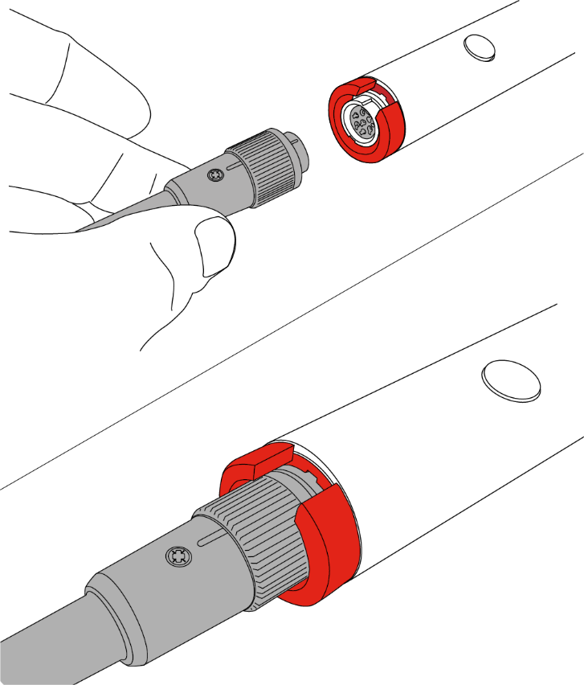
8. Solo Battery Batons, Chargers & Accessories
CAUTIONS & WARNINGS
We all take chargers and rechargeable battery’s for granted. Always read the instructions!
Most rechargeable battery’s and chargers carry the following cautions and warnings:
Do not allow a hot battery to cycle charge
Do not charge the battery outside the specified operating temperature range:
Solo 370 Lithium - (5-45°C). – Fault indicated – Flashing Red LED
Solo 760/770 NiMH (10-35°C)
or in direct sunlight
or near a heat source
or cover/insulate a charging battery and/or charger
Lithium battery packs are classified as Dangerous Goods
Notes:
We all take rechargeable battery packs for granted. - Read instructions
Fire statistics show that incorrect use or faulty rechargeable battery packs and chargers are a concert
Key Cautions and warnings
Never leave a charging battery unattended
Do not cover battery or charger when in use
Do not expose a charging battery to direct sunlight or heat
Do not allow a charger to cycle charge a hot battery
Do not leave charger connected to a fully charged battery if power to the charger could be repeatedly disrupted. Potential of overheating.

Slide 5
8. Solo Battery Batons, Chargers & Accessories
SOLO BATTERIES & CHARGERS – IN USE
All rechargeable battery packs are consumable products
Typical life - 500 cycles or 2 to 3 years.
More frequent charging
up to 8 years with care!
Date code on Solo 760/770 battery batons
No date code or unreadable = very old baton
Charge times
Solo 370 = up to 2 hours / Solo batons = up to 90 mins
Solo battery batons
Battery baton damage (deformed or warped)
Avoid accidental cycle charging (Solo 725/726/727 Mk1)
Avoid heat; sunlight or insulation during charging
Use of correct charger
Solo 727 mk1 (3Ah) is not compatible with Solo 760 2.2Ah – wired safe!
Notes:
Solo battery pack deformation
As the battery cells are arranged in a line to form the battery baton, any excess heat via insulation or cycle charging can cause a deformation of the battery. The latest Solo 727 mk2 overcomes this issue and cuts out the charge cycle in the event of high temperatures, stopping any form of damage the battery baton
All earlier chargers, including Solo 725; 726 and 727 Mk1 can cause a battery if the charger is allowed to cycle charge a hot battery. With modern vehicles that have ‘Stop Start’ technology, the re-engagement of the car engine starter motor causes the a volt drop across the car battery, which then cause the above mentioned chargers to restart the cycling cycle. When this is allowed to happen, the battery baton under charge can over heat and deform. It is also possible for the same issue to occur, when connecting the charger to a permanent 12 volt supply and when many short journeys are under taken. Please disconnect once the baton is fully charged.

Slide 6
8. Solo Battery Batons, Chargers & Accessories
SOLO CHARGER INDICATORS
LED indicator on 727 charger
LED indicator on Solo 370 Battery
Flashing RED/GREEN: Battery check takes 5 mins
Solid RED = Fast Charge
up to 90 mins
Solid GREEN = Trickle Charge
battery ready for use
Flashing RED: Fault
Double RED Flash: Temperature out of range (Only on Solo 727 Mk2)
Flashing RED/GREEN:
Detecting level of charge
Solid RED: Charge
up to 120 mins
Solid GREEN: Fully Charged
Flashing RED: Fault
Notes:
Solo 727 mk2
Has mains and 12 volt connections (do not connect both at the same time). Optional mains leads available with different regional plugs.
Solo 365 Lithium battery and charger
Solo 365 has a all new internal Lithium battery and universal USB charger, with adapters for the following regions -
UK
Europe
US
Australia
The Solo 365 charger is rated at 1.8A. Many users may use aftermarket alternative chargers. Make sure you are aware of the charging current. Modern Smart Phone chargers, charge at 2.1 or 2.4A these chargers are fine to use. If you use a lower powered 1.2A charger, the Solo 370 will not fully charge and the battery LED indicator may stay Red and not change to Green to indicate battery is charged.
The micro USB lead that is supplied is specifically designed for efficient and fast charging of the Solo 370, use of an alternative micro USB lead may cause the Red LED to flash, especially if the lead is long and the conductors are thin.
If in doubt, always used the supplied charger and lead, which are available to purchase separately under part number - Spare1060-001
Around 200 test from a Solo 370 battery in good condition and state of charge

Slide 7
8. Solo Battery Batons, Chargers & Accessories
SOLO BAGS
Solo 610 & Solo 611 Pole Bag
Solo Urban Kit
Notes:
Solo 610, is a large capacity holdall that has three internal sections; sleeves to carry two battery batons and a front pocket to hold a Solo 200 removal tool.
Plenty of room for two separate Solo testers; charger; spare aerosols; tools and still room for sandwiches!
Note: As the capacity of the Solo 610 is large, it is very easy to overload the bag and either cause back strain or damage the bag.
Solo 602, is a suitable pole bag that will hold one telescopic pole and three separate extension poles. The Solo 602 can be attached to the top of the Solo 610 for ease of carriage to and from site.
Solo 611, is our recently introduced Urban Rucksack that has multiple compartments for one test head; consumable; battery pack and charger. There is also a place to carry a laptop and power supply.
Solo 612, is bag specially designed to carry the new Urban Solo poles. One Solo 110 4 section telescopic and three Solo 111 extensions

Slide 8
Notes:
Solo Urban Kit
This slide shows a YouTube video of the Solo Urban kit. The video can be found here - https://youtu.be/CvSE9vFA68c

Slide 9
TESTING & MAINTENANCE OF FIRE DETECTION SYSTEMS
COURSE OVERVIEW
2020 CPD Revised Edition
1
2
3
4
5
6
Competency & Responsibility
British Standards & Best Practice
Unwanted Fire Signals
Aerosol
Canisters
Solo 330, 460 & 423
Testifire
7
8
9
10
11
12
Solo 365
Solo Battery Batons, Chargers & Accessories
ASD System Testing
Removal & Cleaning
Working at Height
General Testing
Tips & Care of Products
Notes:
Up Next –

Slide 10
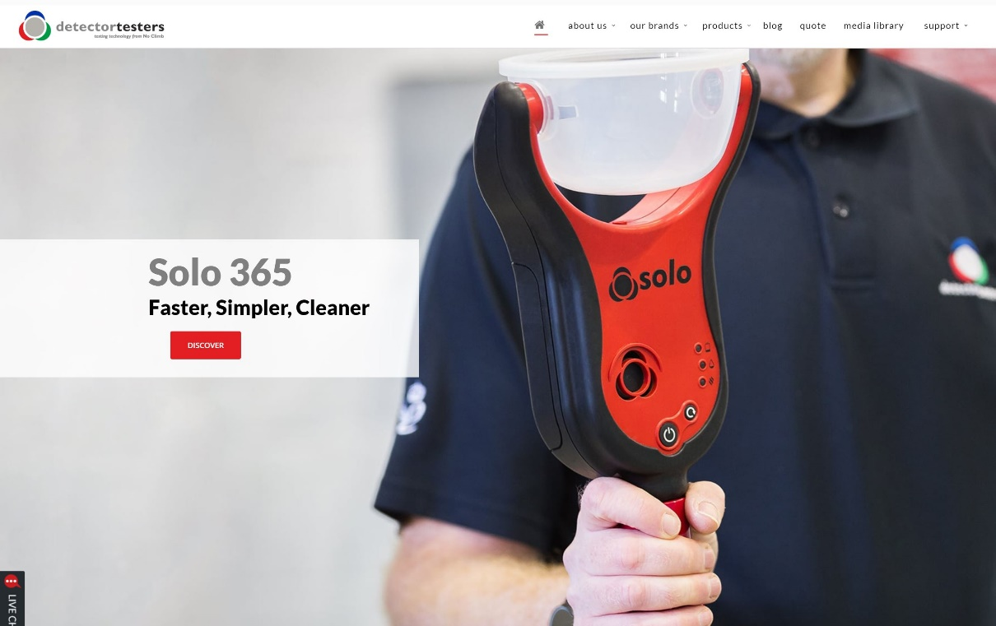
KEEP IN TOUCH
Detectortesters1
@NoClimbProducts
Detectortesters (No Climb Products Ltd)
Detectortesters1
Notes:
That concludes this section…
If you want to know more about our products, please see the detectortesters website or alternatively check out some of our product videos on YouTube.
We also have other training courses available on our website.
Look forward to you joining me on the next section

