Slide 1
TESTING & MAINTENANCE OF FIRE DETECTION SYSTEMS
COURSE OVERVIEW
2020 CPD Revised Edition
1
2
3
4
5
6
Competency & Responsibility
British Standards & Best Practice
False Alarms
Aerosol
Canisters
Solo 330, 460 & 423
Testifire
7
8
9
10
11
12
Solo 365
Solo Battery Batons, Chargers & Accessories
ASD System Testing
Removal & Cleaning
Working at Height
General Testing
Tips & Care of Products
Notes:
Up Next –

Slide 2
11
Working at Height

Slide 3
11. Working at Height
SOLO HEIGHT
ACCESS POLES
Available in one, two or four telescopic sections
Feet on the floor access to out of reach detectors
Save time, cost, disruption and risk to safety that ladders, scaffolding or access gear represents
Designed non-conductive
Compatible with Solo and Testifire
Notes:
Benefits of using Solo height access poles
Access poles are required for detectors out of normal reach. Their use saves the time, cost, disruption and risk to safety that ladders, scaffolding or access gear represents. The value of these access poles over ‘other poles’ is not just the quality of their design and manufacture. It becomes evident when they are required on a daily basis and / or are used at great heights. Pull-wound glass fibre construction provides non conductivity with an optimum strength to weight ratio and high tolerance manufacture ensures minimum possible whip or bend at height relative to weight and cost. This, coupled with the simple locking mechanism of the telescopic sections means that these access poles combine ease of use with design and manufacturing excellence.
Optimum strength to weight ratio
Minimum possible whip or bend at height
Certified non-conductivity
Available in one, two or four telescopic sections
Simple locking mechanism and easy to use
Outstanding quality backed by lifetime warranty

Slide 4
11. Working at Height
SOLO POLE
RANGE
A Solo 100 + 3 x Solo 101 gives maximum access height of 9m*
Solo 100
4 Section Telescopic Pole
Length = 1.26m
Extends to 4.48m
Max reach = 6.0m
weight = 1600grams
Solo 108
2 Section Telescopic Pole
Length = 1.26m
Extends to 2.20m
Max reach = 3.50m
weight = 610grams
Length = 1.13m
Extends to N/A
Max reach = 2.6m
weight = 350grams
Solo 101
Extension Pole
* Subject to risk assessment
Notes:
Solo Poles - Product Information
Solo height access poles are specifically designed only for use with the Solo, Testifire and TruTest product ranges manufactured by detectortesters, allowing access to fire detectors at heights up to 9m (subject to a risk assessment).
It is important to understand the Solo pole range so that you can select the appropriate pole for the task.
Solo Height access Pole product range
Solo 100 – 4 section telescopic pole
Extends from 1.26m to 4.48m in 4 sections for access up to 6.00m approx. (including height of man)
Dimensions - OD = 48mm. Weight – 1620 grams
SPARE1000-001 End Cap For Telescopic Solo 100
Solo 108 – 2 section telescopic pole
Extends from 1.27m to 2.20m In 2 sections for access up to 4.20m approx. (including height of man).
Dimensions - OD = 48mm. weight – 610 grams
Solo 101 – extension pole
Extension Pole 1.13m length. Gives reach of up to 2.6m
Dimensions - OD = 48mm. Weight - 375 grams
Solo 110 – ‘Urban’ 4 section telescopic pole
Extends from 0.5m to 1.88m in 4 sections. For access up to 2.6m
Dimensions – OD = 48mm Weight - 1000grams
SPARE1000-001 End Cap For Telescopic Solo 100
Solo 111 – ‘Urban’ extension pole
Extension pole 0.5m length. Gives reach of up to 2m
Dimensions – OD = 48mm Weight - 300grams
Typical Ceiling heights
It is estimated that in the UK 20% of ceilings are above 6m. A light weight pole combination to reach most detectors would be a Solo108 and 2 x Solo 101 extensions.

Slide 5
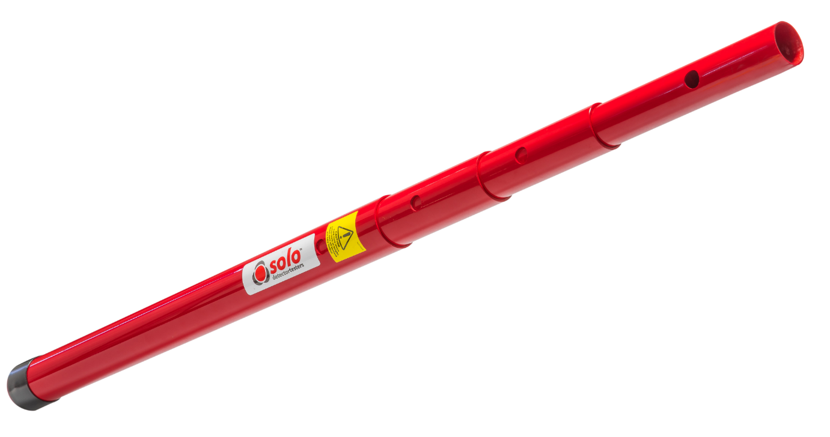
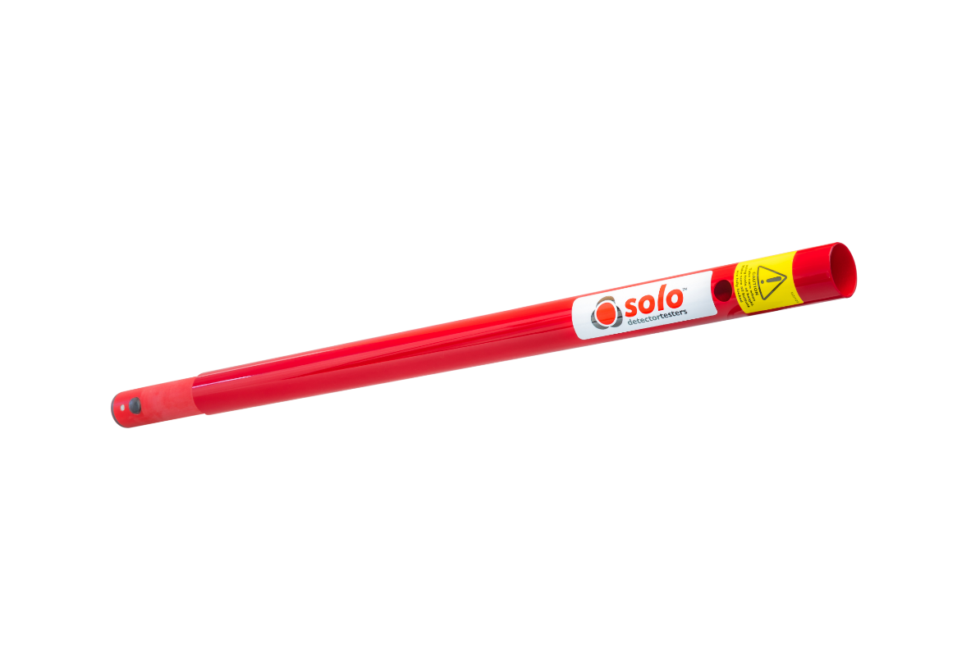
11. Working at Height
SOLO POLE
RANGE
A Urban Solo 110 + 3 x Urban Solo 111 gives maximum access height of 5m*
Solo 110
Urban 4 Section Telescopic Pole
Length = 0.5m
Extends to 1.88m
Max reach = 3 m
weight = 1000grams
Solo 111
Urban Extension Pole
Length = 0.5m
Extends to N/A
Max reach = 1.6m
weight = 300grams
* Subject to risk assessment
Notes:
Solo Poles - Product Information
Solo height access poles are specifically designed only for use with the Solo, Testifire and TruTest product ranges manufactured by detectortesters, allowing access to fire detectors at heights up to 9m (subject to a risk assessment).
It is important to understand the Solo pole range so that you can select the appropriate pole for the task.
Solo Height access Pole product range
Solo 100 – 4 section telescopic pole
Extends from 1.26m to 4.48m in 4 sections for access up to 6.00m approx. (including height of man)
Dimensions - OD = 48mm. Weight – 1620 grams
SPARE1000-001 End Cap For Telescopic Solo 100
Solo 108 – 2 section telescopic pole
Extends from 1.27m to 2.20m In 2 sections for access up to 4.20m approx. (including height of man).
Dimensions - OD = 48mm. weight – 610 grams
Solo 101 – extension pole
Extension Pole 1.13m length. Gives reach of up to 2.6m
Dimensions - OD = 48mm. Weight - 375 grams
Solo 110 – ‘Urban’ 4 section telescopic pole
Extends from 0.5m to 1.88m in 4 sections. For access up to 2.6m
Dimensions – OD = 48mm Weight - 1000grams
SPARE1000-001 End Cap For Telescopic Solo 100
Solo 111 – ‘Urban’ extension pole
Extension pole 0.5m length. Gives reach of up to 2m
Dimensions – OD = 48mm Weight - 300grams
Typical Ceiling heights
It is estimated that in the UK 20% of ceilings are above 6m. A light weight pole combination to reach most detectors would be a Solo108 and 2 x Solo 101 extensions.

Slide 6
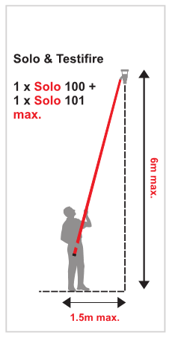
11. Working at Height
SAFE USE OF SOLO HEIGHT ACCESS POLES
9m is maximum recommend reach subject to a risk assessment
Never use more than 3 extensions together or attached to a telescopic pole
At heights up to 6m do not over stretch
At heights of 6m and above. Always use the pole vertically
If inexperienced or lack confidence ask for assistance
Notes:
Recommended distance (angle)
When using Solo height access poles it is difficult to estimate angles. It is far easier to estimate the distance from a point under the detector to the operator’s feet.
Up to 6 M height access
When working at heights up to 6 m, the maximum distance from a point on the floor, directly under the detector to the operator’s feet, should not be greater than 1.5m. eg. Solo 108 with the operator’s feet firmly on the ground and not standing on chair or ladder.
6m to 9 m height access
At elevated heights between 6 and 9 m, it is recommended that you always hold the Solo pole in the vertical or near vertical
Above 9 m
Do not use Solo height access poles above 9 m. Consider other height access or test tools (Scorpion) that are available for these situations

Slide 7
11. Working at Height
SAFE USE OF SOLO HEIGHT ACCESS POLES
Risk assessment will dictate appropriate PPE (Hi-Viz; Hard hat; Eye protection; Protective footwear; Cordon off the working area; or any other appropriate protection for the operator and bystanders)
Notes:
Using Solo height access poles is not technically working at height as the operator’s feet should be on the ground. However, to ensure safe use of Solo height access poles it is worth adopting a working practice that includes precautions that are usually taken when the operator’s feet are off the floor.
To prevent fatigue
Use appropriate pole the task
Do not over-reach or over-stretch
Do not use poles at angles greater than specified
Stand with one foot half a stride ahead of the other to increase balance and reduce strain
Where possible share testing workload
Alternate using the pole between the left and right hand side of the body
Take regular breaks
If possible rest the pole foot on the floor
Do not use height access poles if you are unwell, under the influence of drugs or alcohol
Personal protective equipment (PPE)
The appropriate PPE will be dependent on the outcome of the risk assessment which will highlight hazards with the working area.
Employers are responsible for providing, replacing and paying for personal protective equipment.
PPE should be used when all other measures are inadequate to control exposure. It protects only the wearer, while being worn.

Slide 8
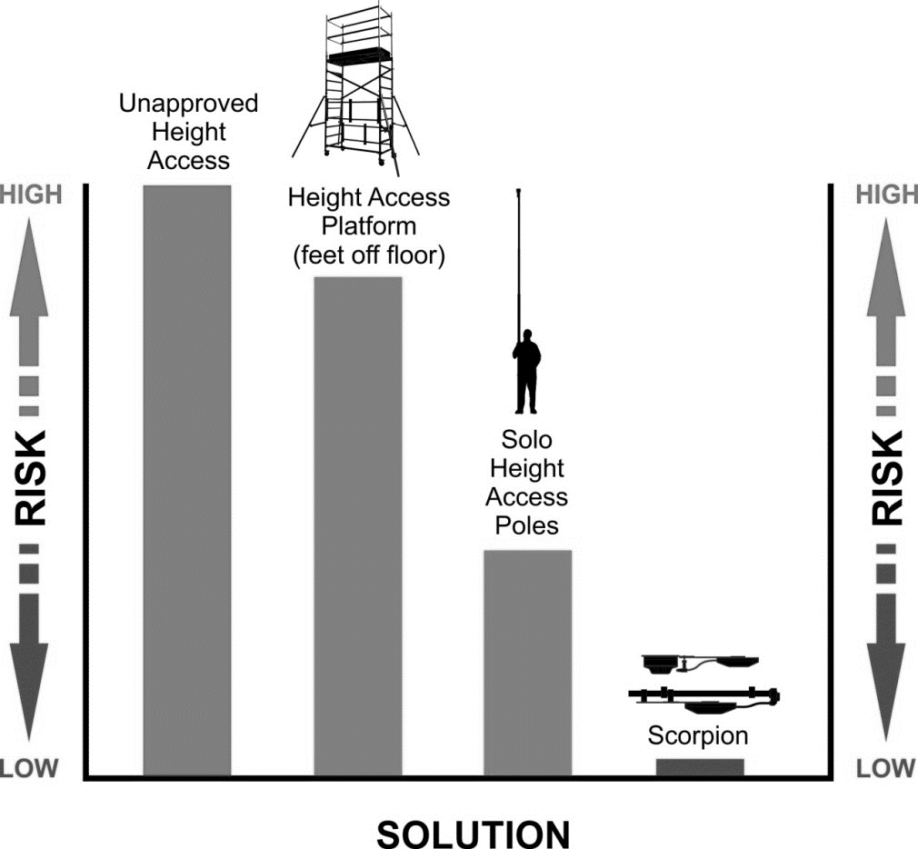
11. Working at Height
SOLUTIONS TO REDUCE RISK
Quantify and compare risks
“Every employer shall ensure that work is not carried out at height where it is reasonably practicable to carry out the work safely otherwise than at height.”
Solo height access poles
‘Feet-on-the-ground’ solution, reduces the risks associated with traditional platform height access equipment.
Scorpion fixed tester
Once installed, Scorpion eliminates future operational risks over the life time of fire detection system.
Notes:
Solutions to reduce risk when test and maintaining detectors at height
There are certain situations where the only suitable solution is to use ‘feet-off the ground’ height access equipment (such cherry picker; platform or ladders etc.), when installing; commissioning or maintaining fire detection system.
Where possible consider other solutions that enable the operator to keep feet on the ground when carrying out ongoing maintenance of a fire detection system, which will either reduce or eliminate risks.
Using Solo height access poles removes a lot of risks that are associated with working with ‘feet-off the ground’ height access equipment. It does not eliminate all risks!
One option that will eliminate future operational risks associated with the ongoing maintenance of smoke detectors mounted at height, is to install a hard-to-access test solution such as Scorpion, which can be used for both smoke point type detectors and ASD systems

Slide 9
TESTING & MAINTENANCE OF FIRE DETECTION SYSTEMS
COURSE OVERVIEW
2020 CPD Revised Edition
1
2
3
4
5
6
Competency & Responsibility
British Standards & Best Practice
Unwanted Fire Signals
Aerosol
Canisters
Solo 330, 460 & 423
Testifire
7
8
9
10
11
12
Solo 365
Solo Battery Batons, Chargers & Accessories
ASD System Testing
Removal & Cleaning
Working at Height
General Testing
Tips & Care of Products
Notes:
Up Next –

Slide 10
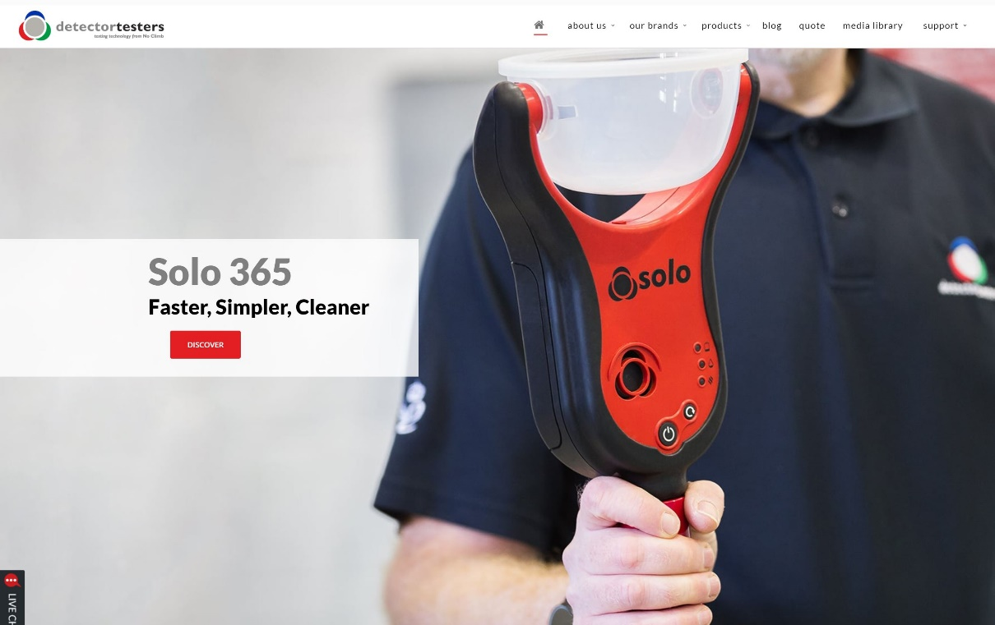
KEEP IN TOUCH
Detectortesters1
@NoClimbProducts
Detectortesters (No Climb Products Ltd)
Detectortesters1
Notes:
That concludes this section…
If you want to know more about our products, please see the detectortesters website or alternatively check out some of our product videos on YouTube.
We also have other training courses available on our website.
Look forward to you joining me on the next section

