Slide 1
TESTING & MAINTENANCE OF FIRE DETECTION SYSTEMS
COURSE OVERVIEW
2020 CPD Revised Edition
1
2
3
4
5
6
Competency & Responsibility
British Standards & Best Practice
False Alarms
Aerosol
Canisters
Solo 330, 460 & 423
Testifire
7
8
9
10
11
12
Solo 365
Solo Battery Batons, Chargers & Accessories
ASD System Testing
Removal & Cleaning
Working at Height
General Testing
Tips & Care of Products
Notes:
Up Next –

Slide 2
12
General Testing
Tips & Care of Products

Slide 3
12. General Testing, Tips & Care of Products
IDENTIFYING DETECTOR UNDER TEST
What is it?
Is it a smoke, heat, CO or multi-sensor fire detector?
What about domestic alarms; CO life safety or fire alarm?
Cigarette smoke alarm?
If multi-sensor, what mode of operation?
If heat, what is the activation temperature?
Correct identification, will help you test correctly
Highlights the importance of
Manufacturer's product training
Keeping site documentation up to date
Notes:
Identifying detector under test
Identifying the detector that you are about to test is most important so that you can carry out an appropriate test and use the correct test equipment.
Is it a smoke, heat, CO or multisensor fire detector?
What about domestic alarms; CO life safety or other sensors?
Importance of manufacturer’s product training cannot be under stated and will help you identify the detector to be tested.
Heat detector can cause most issues
What is activation temperature? Will the heat tester I have activate the heat detector?
Position of thermistor can mean that a different test technique may need to be employed for battery powered heat testers.
Product tolerances can mean that a 90°C heat detector does not activate until 100°C is applied. This detector can still be within tolerance, but can present a testing problem to the CP.
Multisensor
What sensors - What mode = what test tool to use
Keep Site documentation up to date

Slide 4
12. General Testing, Tips & Care of Products
FIRE DETECTOR
TIME TO ALARM
Activation time controlled by…
In-built delays (some programmable)
System polling
Build up of dirt and dust in detector chamber
Use of correct test equipment and test procedure
Ambient conditions:
Temperature
Air flow
Notes:
Detector time to alarm
It is important to understand that each make and model of fire detector has a time to alarm. Further delays can come into play from the polling of the panel to the detector and also any additional programmed delays/configurations that can be added via the panel.
Time to alarm is particular important to be aware of for aerosol canister users (both handheld and dispenser). Always follow instructions and take care not to over apply.
Multisensors are looking for more than one fire like phenomena. Applying just smoke to some multisensors will not activate an alarm. Others will activate after a long delay (up to 2 mins)

Slide 5
12. General Testing, Tips & Care of Products
TESTING CO
DETECTORS / ALARMS
CO sensors can be found in
Fire detectors
CO life safety alarms
Car park ventilation systems
CO generation
On demand (Testifire capsules)
Stored (canisters)
Activation levels
Carbon Monoxide in Fire detector
40-100ppm
Carbon Monoxide life safety
30ppm no alarm before 120 minutes
50ppm no alarm before 60 minutes and alarm in less than 90 minutes
100ppm no alarm before 10 minutes and alarm in less than 40 minutes
300ppm alarm in less than 3 minutes
What is CO and how is it produced?
Notes:
CO Detectors
Before we talk about testing CO fire detectors it is worth covering Carbon monoxide (CO) in more detail.
What is CO?
Carbon monoxide (CO) is a colourless, odourless, tasteless, poisonous gas produced by incomplete burning of carbon-based fuels, including gas, oil, wood and coal. Carbon-based fuels are safe to use. It is only when the fuel does not burn properly that excess CO is produced, which is poisonous. When CO enters the body, it prevents the blood from bringing oxygen to cells, tissues, and organs.
CO Fire detectors
CO detectors, if installed in the correct location, do help reduce false alarms.
CO Life safety alarms
Carbon monoxide is a product of incomplete combustion of organic matter due to insufficient oxygen supply to enable complete oxidation to carbon dioxide (CO2). Carbon monoxide poisoning occurs after enough inhalation of CO.
You can't see it, taste it or smell it but CO can kill quickly without warning. According to the HSE statistics around 20 people die from CO poisoning caused by gas appliances and flues that have not been properly installed, maintained or that are poorly ventilated. Levels that do not kill can cause serious harm to health if breathed in over a long period. In extreme cases paralysis and brain damage can be caused as a result of prolonged exposure to CO. Increasing public understanding of the risks of CO poisoning and taking sensible precautions could dramatically reduce this risk.
Exposures at 100ppm or greater, can be dangerous to human health.
CO Life safety alarms are designed to detect and activate an alarm for different CO ppm for a given time.
CO Concentration/ppm and alarm times
30ppm no alarm before 120 minutes
50ppm no alarm before 60 minutes and alarm in less than 90 minutes
100ppm no alarm before 10 minutes and alarm in less than 40 minutes
300ppm alarm in less than 3 minutes
It is worth being aware that some of the carbon monoxide life safety gas alarms are one shot devices and use of an Solo C3 canister could make the detector inoperative after testing. Always check with the detector manufacturer for their recommendations
CO generation
CO can be stored or generated on demand. Older technology relies on CO being stored in a aerosol canister and then released under the control of the user. Although the concentration of stored CO is very low within an aerosol canister of CO test gas, concerns exist over storing CO due to potential health hazards around CO. Testifire TC3 CO capsules overcome this fear as CO is only produced by Testifire as and when it is required and no CO is stored.
Testifire generates CO, by heating a benign activated carbon cloth which is contained within a replaceable capsule plugged directly into the side of a CO-enabled Testifire unit (i.e. Testifire 2000 series).
This revolutionary method of CO production and delivery eliminates the need for CO to be stored and ensures CO is only produced when needed.
Genuine and non-flammable CO stimulus
CO only produced during test activation
Low, safe levels of CO generated only
Multiple failsafe features eliminate risk of unwanted CO
No CO stored or pressurised containers
Efficient detector activation
CO levels ppm in fire detectors
CO fire detectors typically activate between 40-100ppm (parts per million)
As we are concerned here with testing CO fire detectors the levels of CO are significantly low enough not be of concern or danger to life.
Testifire produces approximately 100ppm of CO within the cup. This is a sufficient level to test the CO sensors within all known CO and multisensor fire detectors on the market.
Time to alarm
As with heat and smoke detectors, the time to alarm is controlled by inbuilt delay; system wiring a panel configuration. As previously mention CO life safety alarms can take longer to activate if 300ppm of CO is maintained during a test.

Slide 6
12. General Testing, Tips & Care of Products
SPECIAL
SITES
Flammable/explosive environments
No test equipment is suitable = carry out risk assessment
Clean Rooms
No test equipment is suitable = carry out risk assessment
High Voltage
No test equipment is suitable = carry out risk assessment
Notes:
Flammable or explosive environments
None of our products have been risk assessed or evaluated for use in such environments. We are aware that some end users carry out their own risk assessments and have used our products in such environments. It is an extremely costly process to make products for use in these environments, this is the main reason why our products have not been adapted to test these type of heat detectors.

Slide 7
12. General Testing, Tips & Care of Products
TESTING IN FLAMMABLE AND EXPLOSIVE ENVIRONMENTS – RECOMMENDATIONS
Maintenance engineer recommendations
Ask to see the FRA and DSEAR report
If neither have reference to special testing procedure, ask your client to involve the Fire Risk Assessor to make sure the FRA and DSEAR report documents are current, up to date and document the need for the above mentioned special test procedures
Variation to Standard
Document that the instructions for functional test follow guidance given by the DSEAR and FRA
None of our products are designed to be used in ATEX areas.
DSEAR report (The Dangerous Substances and Explosive Atmospheres Regulations 2002
Should also document the need for special testing procedure for Intrinsically Safe fire detectors
Fire Risk Assessment (FRA)
Should document the areas where Intrinsically Safe (IS) fire detectors have been installed in the premises
Should documents the need for a special testing procedure to enable functional testing of the Intrinsically Safe fire detectors in a safe manner. This may involve decommissioning or removing ATEX hazards from the area to make it safe for the testing to be carried out in-situ
Notes:
Testing in Flammable and Explosive Environments
None of our products have been risk assessed or evaluated for use in ATEX Areas.
Fire Risk Assessment for ATEX environments
Fire Risk Assessment (FRA) of ATEX environments should be completed by a competent person and should document the areas where Intrinsically Safe (IS) fire detectors have been installed in the premises. It is recommended that the FRA also documents the need for a special testing procedure to be followed to enable functional testing of the Intrinsically Safe fire detectors in a safe manner.
This may involve decommissioning or removing ATEX hazards from the area to make it safe for the testing to be carried out in-situ.
If it is not practical to remove ATEX hazards, this would mean that testing in the installed location will not be possible. Detectortesters would recommend the removal of the IS fire detectors from the ATEX environment for testing in a non-ATEX environment.
This would be against the recommendation in section 45of BS5839:1 2017.

Slide 8
12. General Testing, Tips & Care of Products
INSPECTION OF EQUIPMENT
Technically speaking, our test equipment is not classified as height access equipment as the operator’s feet are on the floor. However, it is deemed best practice to give the same level of care when inspecting kit to avoid drops or accidents due to damage or modified equipment.
Always, inspect all detector test and maintenance equipment, before and after use. In regards to Solo height access poles, pay particular attention to:
Tool end of pole
Pole foot
Locking buttons
Rubber foot (missing)
Do not use any detector test and maintenance equipment, if damaged or modified in anyway. Example of modification: Holes for joss sticks etc.
Notes:
Inspection of equipment
Technically speaking, our test equipment is not classified as height access equipment as feet are on the floor. However, it is deemed best practice to give the same level of care when inspecting kit to avoid drops or accidents.
Solo poles should always be inspected before and after use to make sure that no damage is encountered.
You need to make sure that your test equipment is in good working order and is not damaged or modified in anyway.
Check –
Locking buttons to make sure they are not damaged; dirty and engage correctly
Check the length of the pole for signs of damage
Make sure that telescopic poles have the rubber foot fitted. If missing.
Testers and removal tools should also be inspected as damaged equipment could be the cause of an accident.

Slide 9
12. General Testing, Tips & Care of Products
LOOKING AFTER YOUR POLE
Take care of your kit:
Return poles to Solo 602 bag when not in use
Avoid trip hazards
Do not leave extended poles unattended
Do not modify or attempt repair
Inspect before and after use
Tool end of pole
Pole foot
Locking buttons
Rubber foot (missing)
Cleaning
Keep poles clean
Keep grit and dirt away from pole buttons
Notes:
Looking after your pole
Take care of kit
Always return poles to the protective Solo 602 pole bag when the poles are not in use
Do not leave extend poles unattended or in a way that could cause a trip hazard.
Cleaning
Most kit requires some daily attention to keep it in good condition.
Wiping with a damp cloth is recommended
Check locking buttons to make sure that they engage correctly.
Use protective bags when not in use
Do not cause a trip hazard by leaving kit around!

Slide 10
The basic concepts of The Regulatory Reform (Fire Safety) Order 2005 (RRO)
The role and legal obligations of competent & responsible person
The role of the premises manager
How a competent person demonstrates competency
The importance to keep knowledge and skills, relevant and current
The basic duties of the competent person
The intent of the various BS 5839 clauses that relate to test and maintenance of fire detectors /alarms
The difference between commercial detectors and residential alarms
The importance of monitoring and false alarms
Understand what is meant by best practice
How to test detectors correctly using Solo; Testifire and Scorpion products
How to look after your test and maintenance kit
REVIEW OF THE
COURSE OBJECTIVES
By the end of the training course, you will have a full understanding and appreciation of the following subjects:

Slide 11
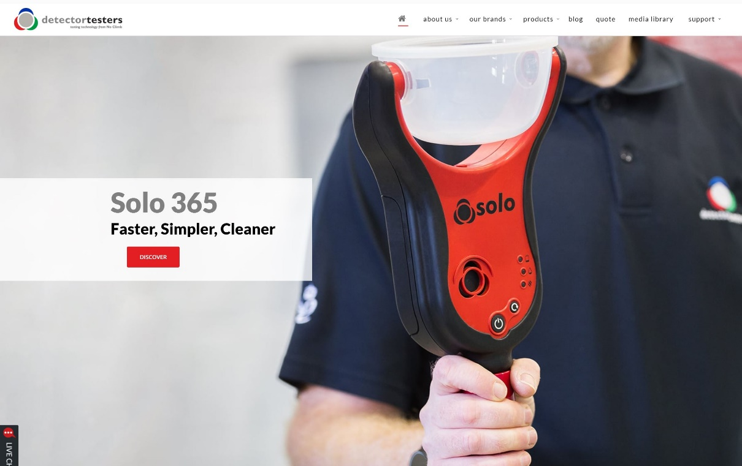
KEEP IN TOUCH
Detectortesters1
@NoClimbProducts
Detectortesters (No Climb Products Ltd)
Detectortesters1
Notes:
That concludes this section…
If you want to know more about our products, please see the detectortesters website or alternatively check out some of our product videos on YouTube.
We also have other training courses available on our website.
Look forward to you joining me on the next section

